Slide 1

OASIS 2D Editor in METAPATH Platform
Common fragments - practical applications
Laboratory of Mathematical Chemistry
Burgas, 2022

Slide 2
Outlook
Aim of this presentation
Basic functionalities & Overview of the 2D editor - refreshment
What is Common fragment – definition
Types common fragments
Practical examples
Notes:
This is the structure of my talks.
First ‘Why we decided to model skin sensitization?’
Next I will talk about the data used, the mechanism of modeled phenomena and developed model, results and finally future work.

Slide 3
Outlook
Aim of this presentation
Basic functionalities & Overview of the 2D editor - refreshment
What is Common fragment – definition
Types common fragments
Practical examples
Notes:
This is the structure of my talks.
First ‘Why we decided to model skin sensitization?’
Next I will talk about the data used, the mechanism of modeled phenomena and developed model, results and finally future work.

Slide 4
Aim of this presentation
This presentation is intended to help users to define structures with common fragments (Markush structures) in MetaPath
All types of common fragments are listed below
However, the focus is set on:
  Positional fragments, when user needs to put a Markush structure in a metabolic map
  Enumeration and chain fragments, when user needs to define a more sophisticated search
  The focus is set on positional fragments, because they represent the Markush structures that user will find in literature sources
  In case of interest, the presentation could be expanded with examples for fragments not currently covered
Notes:
This is the structure of my talks.
First ‘Why we decided to model skin sensitization?’
Next I will talk about the data used, the mechanism of modeled phenomena and developed model, results and finally future work.

Slide 5
Outlook
Aim of this presentation
Basic functionalities & Overview of the 2D editor - refreshment
What is Common fragment – definition
Types common fragments
Practical examples
Notes:
This is the structure of my talks.
First ‘Why we decided to model skin sensitization?’
Next I will talk about the data used, the mechanism of modeled phenomena and developed model, results and finally future work.

Slide 6
Basic functionalities of 2D Editor
Refreshment
2D editor allows to draw:
  Discrete structures (with defined SMILES)
  Dissociating chemicals (e.g. salts)
  Chemicals with stereo information (e.g. plain up, plain down bonds)
  Mixtures
  Mark atoms with radiolabeled isotope (e.g. C14)
Notes:
This is the structure of my talks.
First ‘Why we decided to model skin sensitization?’
Next I will talk about the data used, the mechanism of modeled phenomena and developed model, results and finally future work.

Slide 7
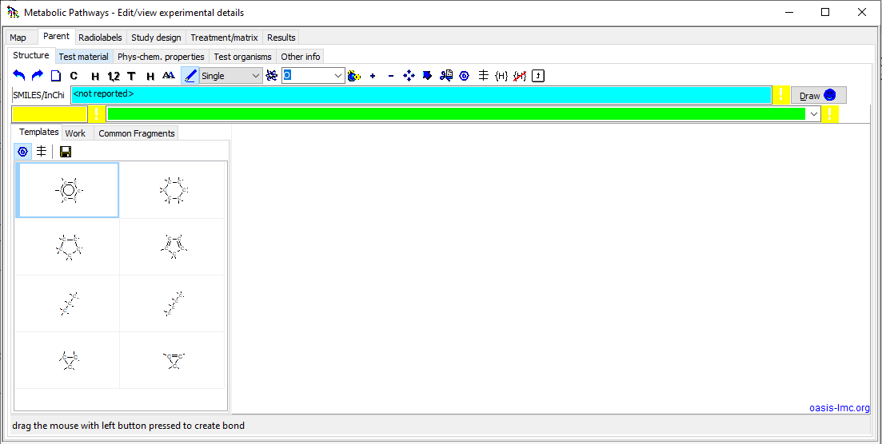
2D viewer and editor
Notes:
This is the structure of my talks.
First ‘Why we decided to model skin sensitization?’
Next I will talk about the data used, the mechanism of modeled phenomena and developed model, results and finally future work.

Slide 8
2D viewer and editor
Toolbar menu
SMILES field
Name field
CAS field
Drawing canvas
Predefined templates
More details about 2D editor could be found in file: OASIS 2D Editor_description.docx
Notes:
This is the structure of my talks.
First ‘Why we decided to model skin sensitization?’
Next I will talk about the data used, the mechanism of modeled phenomena and developed model, results and finally future work.

Slide 9
Outlook
Aim of this presentation
Basic functionalities & Overview of the 2D editor - refreshment
What is a Common fragment – definition and usage
Types common fragments
Practical examples
Notes:
This is the structure of my talks.
First ‘Why we decided to model skin sensitization?’
Next I will talk about the data used, the mechanism of modeled phenomena and developed model, results and finally future work.

Slide 10
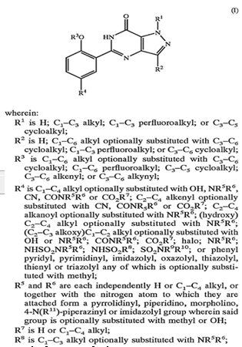
Common fragments - definition
Did you find it familiar ?
“where : R1 ….. “
R2 …….
Rn …………..”
Is it possible to express the substituents (Rn) in METAPATH software?
Yes it is possible, by using OASIS Common fragments.
[1] Johann Gasteiger, Thomas Engel : “Chemoinformatics: A Textbook”

Slide 11
Common fragments - definition
OASIS SMILES is a Markush type structure [1], which have a fixed core called scaffold and variable parts (e.g. common fragments) attached to the scaffold:
  Fixed core (scaffold)
  Variable parts (R groups, common fragment)
Scaffold
Scaffold
C[X1]"@Chain1{-}C{SP3}([X1])([X1])([X1])[V1];1-3c"[V1]C1C2=C(C(=O)NC(c3c{~1}c{~1}c{~1}c{~1}c3O)=N2)NN=1"~1Pos1{-}O{H}[X1];1s"
C[X1]"@Chain1{-}C{SP3}([X1])([X1])([X1])[V1];1-3c"[V1]C1C2=C(C(=O)NC(c3c{~1}c{~1}c{~1}c{~1}c3O)=N2)NN=1"~1Pos1{-}O{H}[X1];1s"
R₁ – OH group
R₂ – C2-C4 alkyl group
Common fragments
Common fragments
Depiction of OASIS SMILES
Representation of OASIS SMILES
[1] Johann Gasteiger, Thomas Engel : “Chemoinformatics: A Textbook”

Slide 12
Common fragments - definition
OASIS SMILES is a Markush type structure [1], which have a fixed core called scaffold and variable parts (e.g. common fragments) attached to the scaffold:
  Fixed core (scaffold)
  Variable parts (R groups, common fragment)
1
2
3
Scaffold
4
5
6
7
8
9
10
11
12
R₁ – OH group
R₂ – C2-C4 alkyl group
Common fragments
Depiction of OASIS SMILES
Generated isomeric forms
[1] Johann Gasteiger, Thomas Engel : “Chemoinformatics: A Textbook”

Slide 13
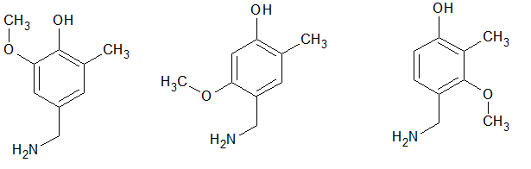
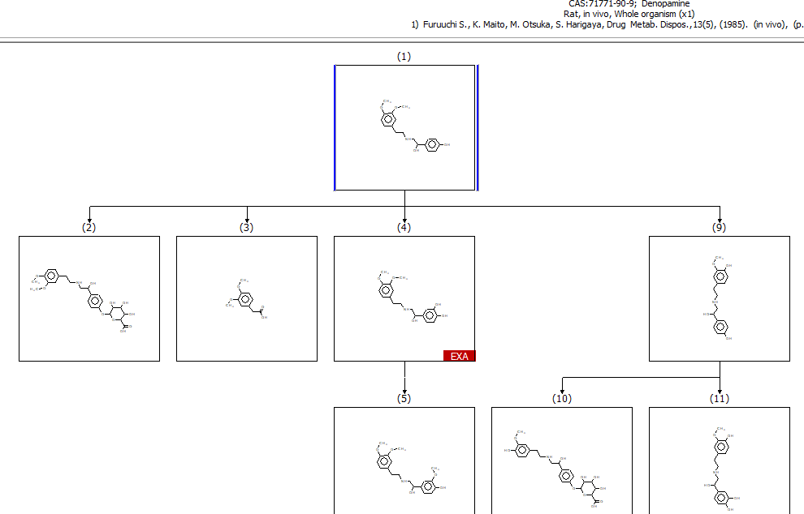
Common fragments
Searching vs. Generation
Generation (Enumeration):
enumerate discrete structures (isomers)
Searching in the maps:
discrete structures (isomers)
discrete chemicals with specific structural requirements
Searching in the map
Positional isomeric forms

Slide 14
Outlook
Aim of this presentation
Basic functionalities & Overview of the 2D editor - refreshment
What is Common fragment – definition and usage
Types common fragments
Practical examples
Notes:
This is the structure of my talks.
First ‘Why we decided to model skin sensitization?’
Next I will talk about the data used, the mechanism of modeled phenomena and developed model, results and finally future work.

Slide 15
Types common fragments
Enumeration
[-OH, -NH₂, -SH]
Chain
Bond migration
[CH=CH]
Cyclic
Positional
[-SO₃H]
Hetero
[N, O]
Descriptors of a generic fragments
Name
Type
Structural units
Bonds to connect to scaffold
Positions to connect to scaffold
Number of fragments to be connected to scaffold
Positional Chain
[Csp³ ₁₋₃]
Exhaust
[C{sp3}≤5, O=1]
15

Slide 16
Types common fragments
Enumeration
Chain
Chain
Bond migration
Cyclic
Positional
Hetero
Positional Chain
Exhaust

Slide 17
Types common fragments
Enumeration
Enumeration
For searching
Chain
Chain
Bond migration
Cyclic
Cyclic
For generation
For searching
Positional
Positional
Hetero
Hetero
Positional Chain
Exhaust
For searching

Slide 18
Outlook
Aim of this presentation
Basic functionalities & Overview of the 2D editor - refreshment
What is Common fragment – definition and usage
Types common fragments
Practical examples
Notes:
This is the structure of my talks.
First ‘Why we decided to model skin sensitization?’
Next I will talk about the data used, the mechanism of modeled phenomena and developed model, results and finally future work.

Slide 19
Examples
Example 3 - illustration of enumeration type fragment for searching specific metabolites in metabolic maps
Enumeration
Example 4 - illustration of chain type fragment for searching homologous series of metabolites
Chain
Bond migration
Cyclic
Example 1 & 2 - illustration of positional type fragment for generating positional isomers of specific metabolite
Positional
Hetero
Detailed instructions how to create and use common fragments are provided on next slides
Positional Chain

Slide 20
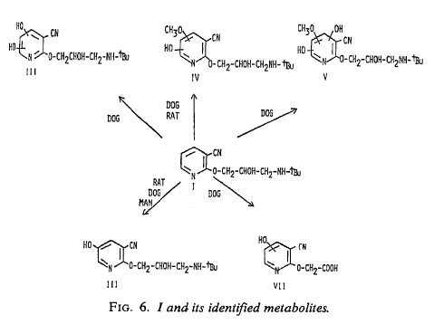
Example 1 – illustration of positional type fragment for generating positional isomers of metabolite
Documented metabolic map
II
III
Metabolites I-III will be defined using positional type fragment
I
Steps illustrating definition of Metabolite I are provided in slides #21-28
Vickers. S et.al. The metabolic disposition of (S)-2-(3-tert-Butylamino-2-hydroxypropoxy)-3-cyanopyridine in rats, dogs, and humans. Drug Metabolism and Disposition, Vol,8, No3. 1980.

Slide 21
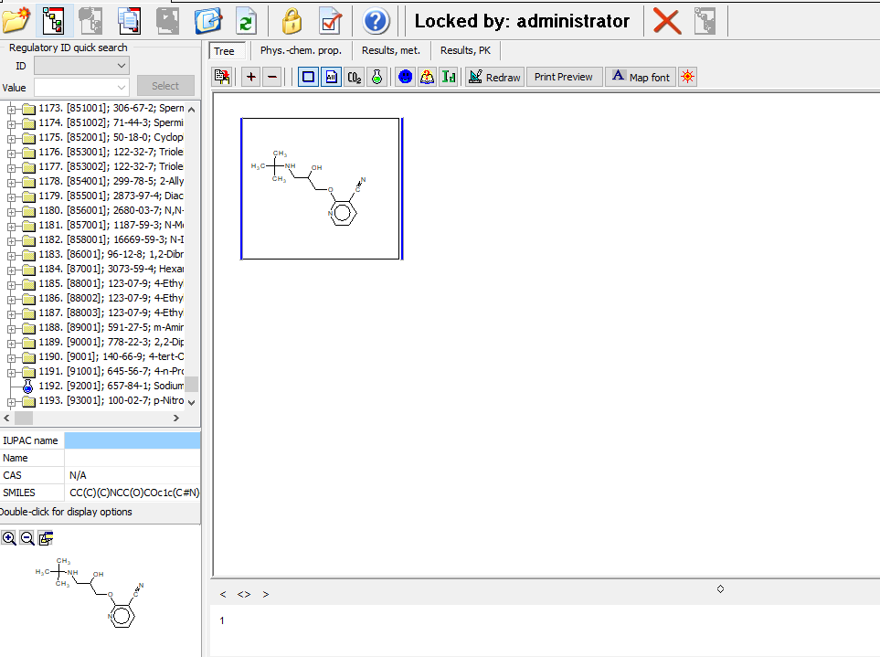
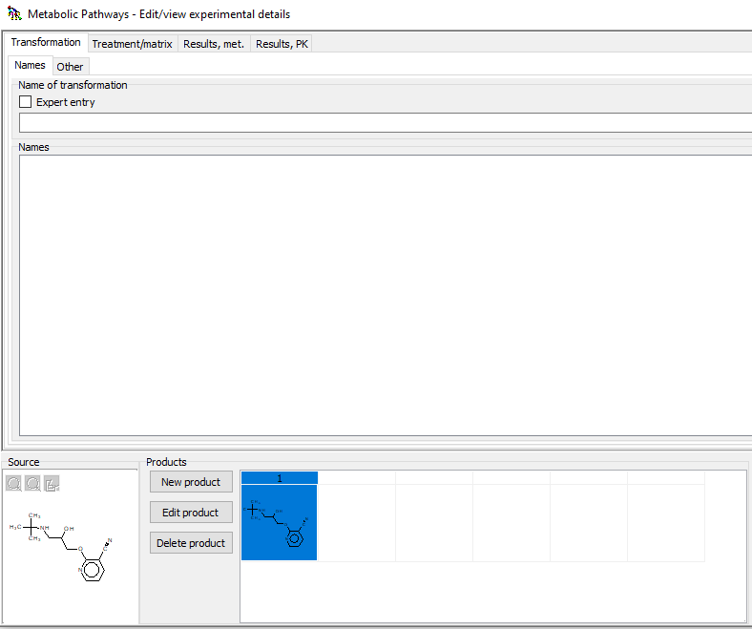
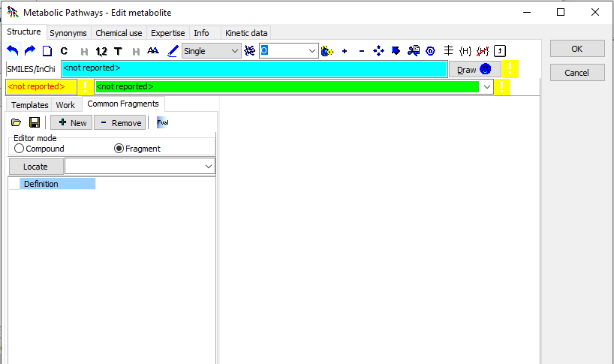
Example 1 – illustration of positional type fragment for generating positional isomers of metabolite
Definition of the common fragment (1)
1
3
4
2
Create new metabolite
Click on Edit product
Switch to Common fragments tab
Select Fragment radio button

Slide 22
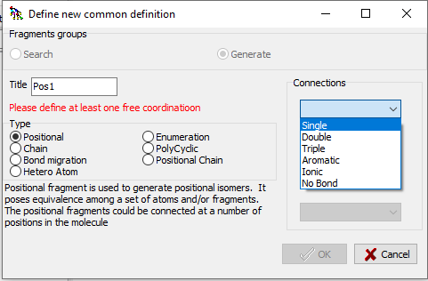
Example 1 – illustration of positional type fragment for generating positional isomers of metabolite
Definition of the common fragment (2)
6
7
5
4
8
Select Positional type fragment
Gave name of the fragment (or keep it as it is)
Select Single bond
Finally click OK

Slide 23
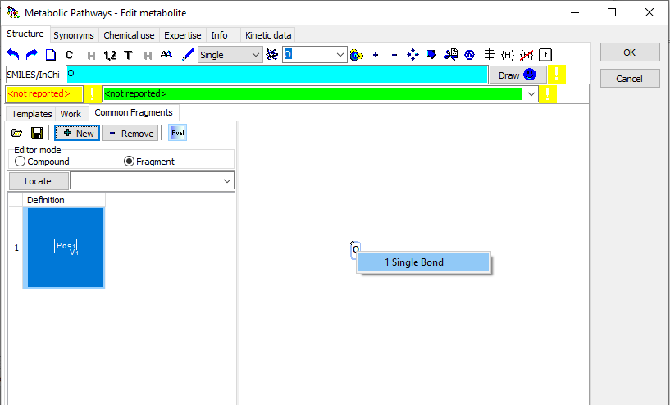
Example 1 – illustration of positional type fragment for generating positional isomers of metabolite
Definition of the common fragment (3)
10
12
9
11
13
Positional type fragment appears in the library
Click on the button to select the O atom
Left click on the blank space
Left click on the Fval button
Right-click over the O atom and select Single bond

Slide 24
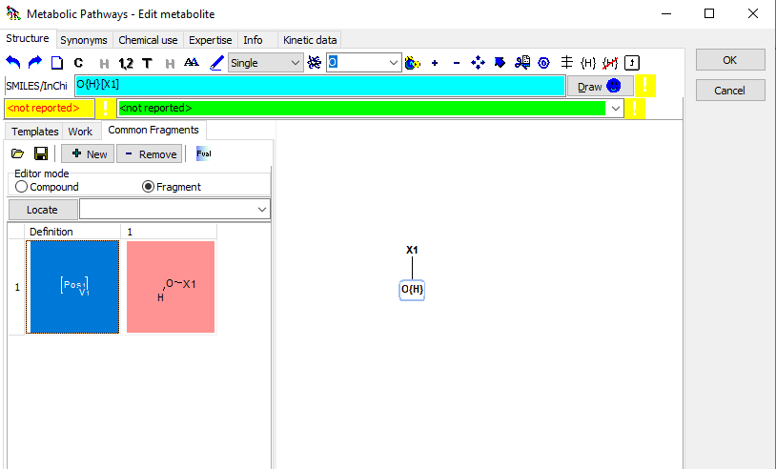
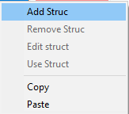
Example 1 – illustration of positional type fragment for generating positional isomers of metabolite
Definition of the common fragment (4)
15
20
14
19
16
17
18
Single bond is created
Click on the button to specify explicitly hydrogen atoms
Left click on over the O- atom to specify that this is the hydroxyl group only
Left click on blue space over the name of the positional fragment
Right click and select Add Struc to add Hydroxyl group to the Pos frag
The hydroxyl group appears. The fragment is ready to be attached to the scaffold!
Click Save button every time when new fragment is created
24

Slide 25
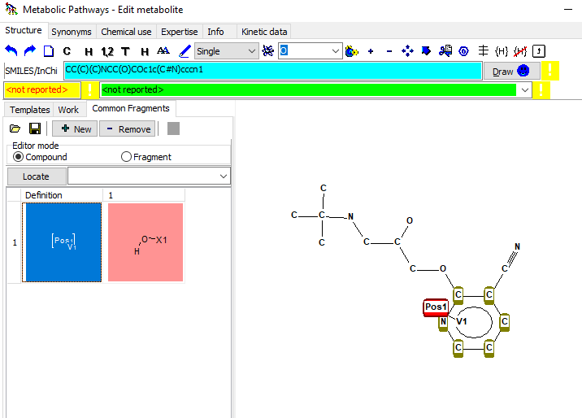
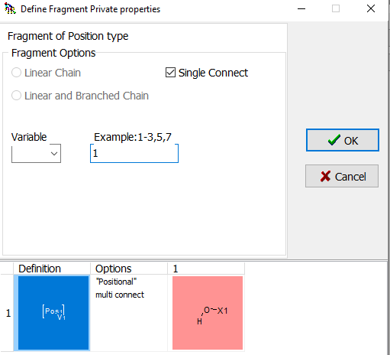
Example 1 – illustration of positional type fragment for generating positional isomers of metabolite
Attachment of common fragment to the scaffold (1)
24
26
21
25
22
23
Select Compound radio button
Single left click on Positional type fragment – the fragment is now selected
Hold the left mouse click pressed and move the cursor close to the scaffold so the atoms in the benzene ring to become green highlighted. Release the mouse to glue the fragment to the scaffold.
24) A new window will appear. Select single connect
25) Add one in the Example box. This means the fragment (i.e. hydroxyl group) will repeat only one
26) Finally click OK.

Slide 26
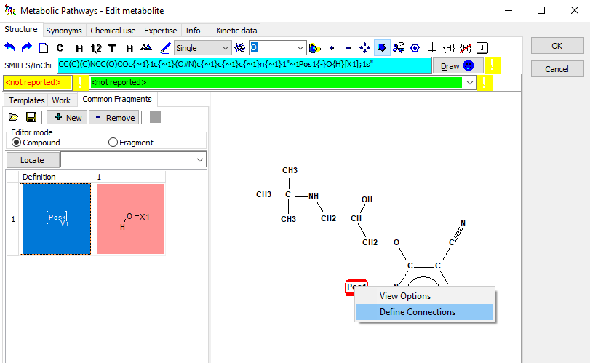
Example 1 – illustration of positional type fragment for generating positional isomers of metabolite
Attachment of common fragment to the scaffold (2)
22
27
28
Perform right-click over the name of the Positional fragment
Select Define Connections from the appeared pop-up menu

Slide 27
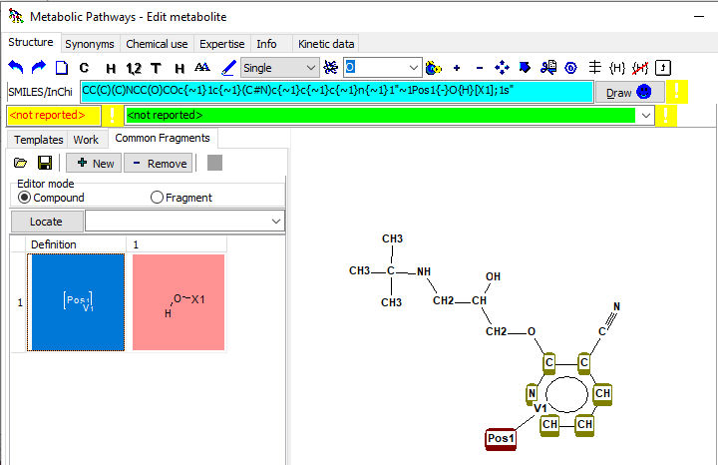
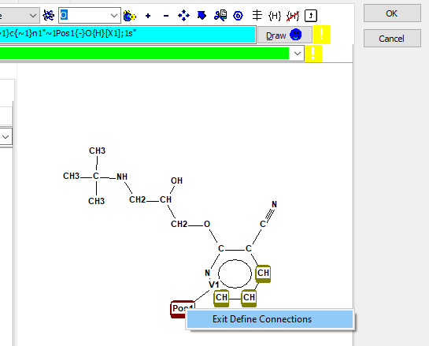
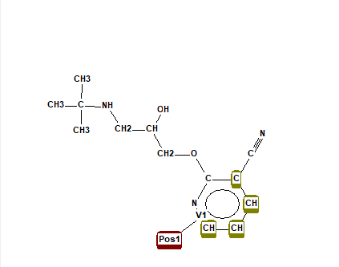
Example 1 – illustration of positional type fragment for generating positional isomers of metabolite
Attachment of common fragment to the scaffold (3)
33
27
31
29
30
32
Initially all atoms are highlighted in green
Single left click over the atoms, where the hydroxyl group cannot be attached. In order to unselect them just left click over them
Only 3 C-atoms of the benzene ring could be replaced with hydroxyl group. Only these 3 atoms should be highlighted in green
Perform right-click over the name of positional fragment, select Exit Define Connections
Click OK
27

Slide 28
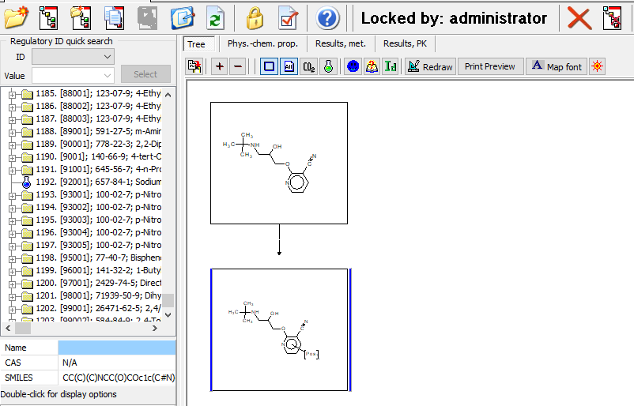
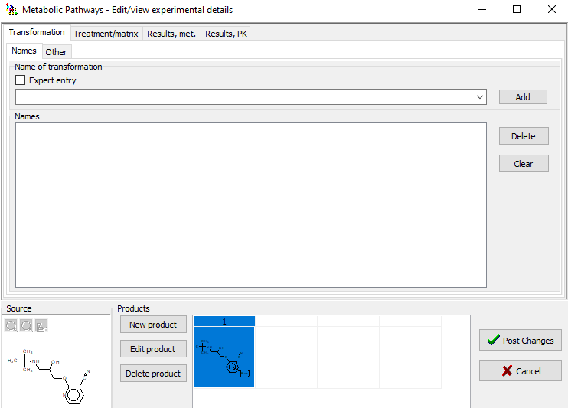
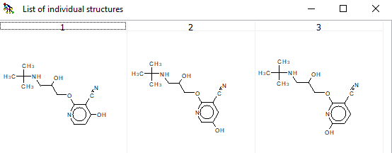
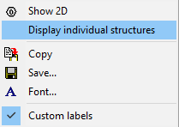
Example 1 – illustration of positional type fragment for generating positional isomers of metabolite
Visualization of generated metabolites
37
34
35
Click Post Changes
Metabolite I appears
Right-click over the metabolite and select Display individual structures
All possible positional isomers are visualized
36

Slide 29
Example 1 – illustration of positional type fragment for generating positional isomers of metabolite
Documented metabolic map
II
III
I
Metabolite I is ready
Vickers. S et.al. The metabolic disposition of (S)-2-(3-tert-Butylamino-2-hydroxypropoxy)-3-cyanopyridine in rats, dogs, and humans. Drug Metabolism and Disposition, Vol,8, No3. 1980.

Slide 30
Example 1 – illustration of positional type fragment for generating positional isomers of metabolite
Documented metabolic map
II
For definition of Metabolite II the already defined positional fragment for Metabolite I will be used. Sequence of steps are given on slides #31-33.
Vickers. S et.al. The metabolic disposition of (S)-2-(3-tert-Butylamino-2-hydroxypropoxy)-3-cyanopyridine in rats, dogs, and humans. Drug Metabolism and Disposition, Vol,8, No3. 1980.

Slide 31
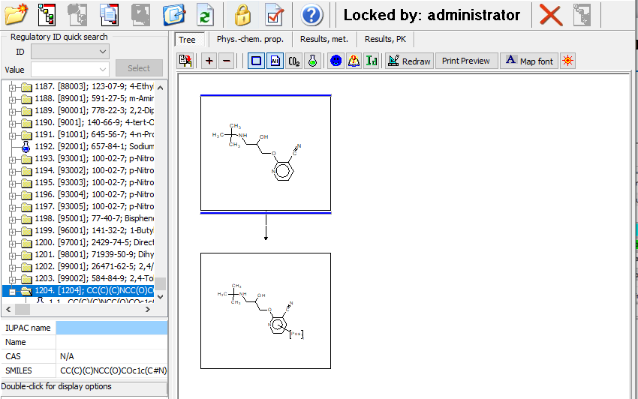
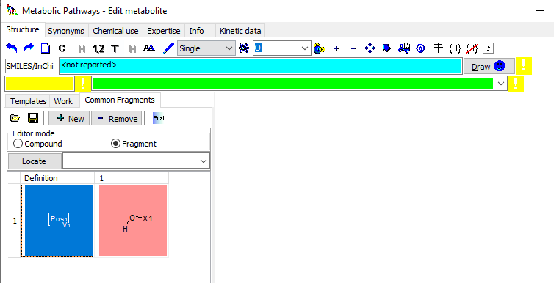
Example 1 – illustration of positional type fragment for generating positional isomers of metabolite
Definition of the common fragment (1)
2
1
4
5
6
3
Select parent chemical
Click to generate child
Click Edit product
Go to Common Fragments section
Switch to Fragment mode
The Position fragment is preserved in the library with fragments and will be used directly
31

Slide 32
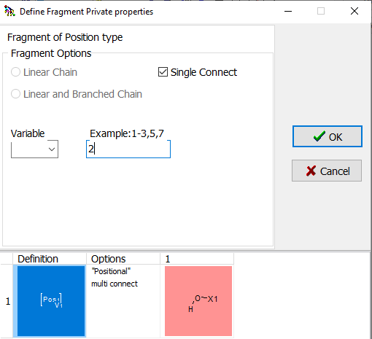
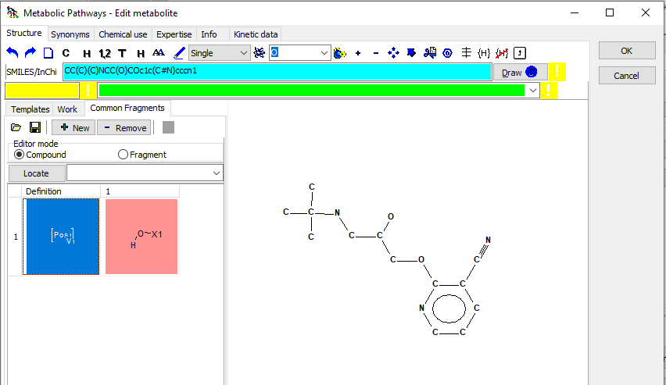
Example 1 – illustration of positional type fragment for generating positional isomers of metabolite
Definition of the common fragment (2)
11
9
10
7
8
Left click over the positional fragment
Left click on the blank canvas
A new window appears, select Single connect
Add 2 in order to say that two Hydroxyl groups are connected to the benzene ring
Click OK

Slide 33
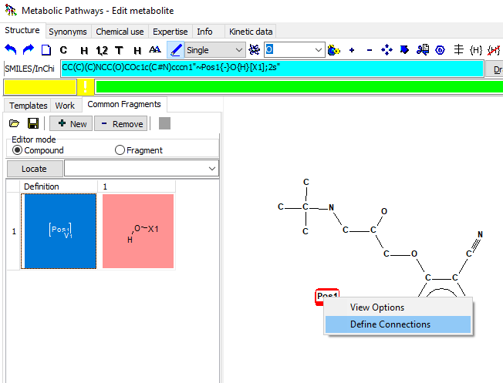
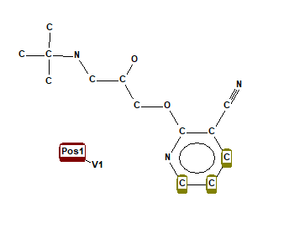
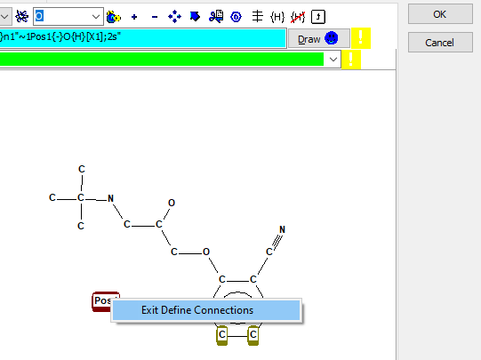
Example 1 – illustration of positional type fragment for generating positional isomers of metabolite
Definition of the common fragment (3)
16
12
14
15
13
Left click over the name of the positional fragment
Select Define Connections
Mark only the atoms whether the hydroxyl group could be connected (single left click to mark the atoms)
Right-click over the name of the positional fragment and click on Exit Define connections
Click OK
33

Slide 34
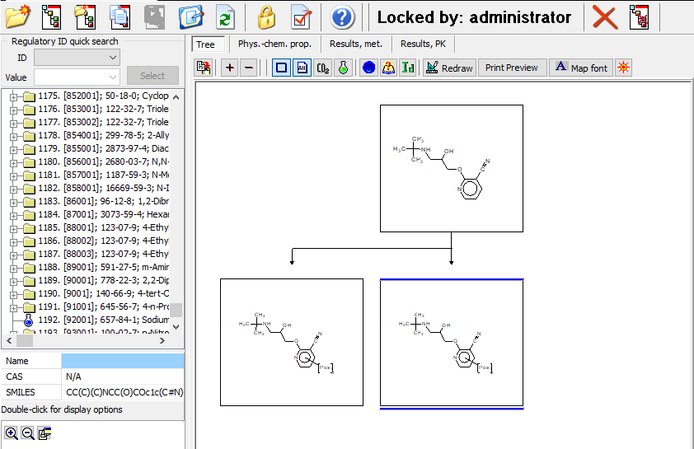
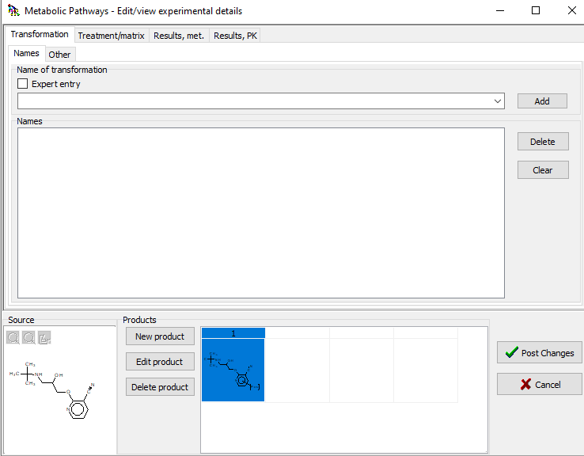
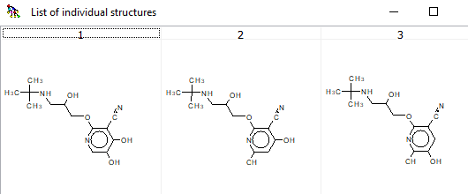
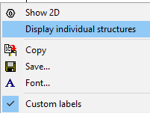
Example 1 – illustration of positional type fragment for generating positional isomers of metabolite
Visualization of generated metabolites
20
17
19
18
Click Post Changes
Metabolite II appears in the map
Right-click over the metabolite and select Display individual structures
All possible positional isomers are visualized

Slide 35
Example 1 – illustration of positional type fragment for generating positional isomers of metabolite
Documented metabolic map
II
Metabolite II is ready
Vickers. S et.al. The metabolic disposition of (S)-2-(3-tert-Butylamino-2-hydroxypropoxy)-3-cyanopyridine in rats, dogs, and humans. Drug Metabolism and Disposition, Vol,8, No3. 1980.

Slide 36
Example 1 – illustration of positional type fragment for generating positional isomers of metabolite
Documented metabolic map
III
For definition of Metabolite III new positional fragment will defined.
Sequence of steps are given on slides# 37-44.
Vickers. S et.al. The metabolic disposition of (S)-2-(3-tert-Butylamino-2-hydroxypropoxy)-3-cyanopyridine in rats, dogs, and humans. Drug Metabolism and Disposition, Vol,8, No3. 1980.

Slide 37
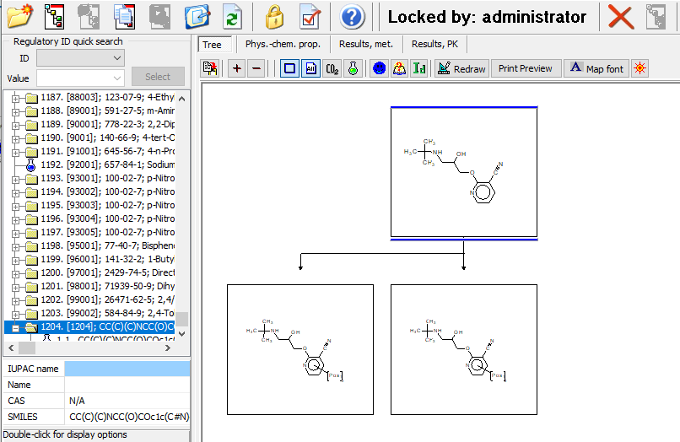
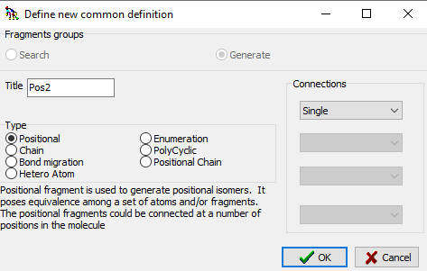
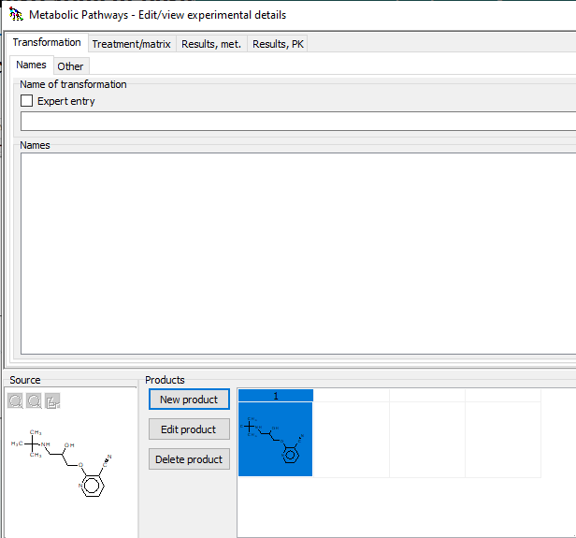
Example 1 – illustration of positional type fragment for generating positional isomers of metabolite
Definition of the common fragment (1)
2
1
4
6
8
9
5
7
10
Select parent chemical
Click to generate child
Click Edit product
Go to Common Fragments section
Switch to Fragment mode
Click on New button to generate new common fragment
Select Positional type
Gave name of the fragment (or keep it as it is)
Select single bond
Click OK
3
37

Slide 38
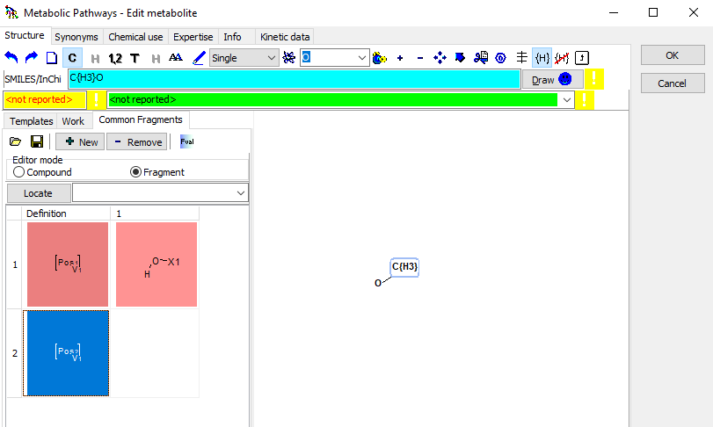
Example 1 – illustration of positional type fragment for generating positional isomers of metabolite
Definition of the common fragment (2)
16
14
12
17
18
13
A new positional fragment appears in the library with fragments
Click on button to select O-atom.
Press left mouse button on blank canvas to add O-atom
Click on pencil button
Position on Oxygen atom, drag to draw the single bond
Click on carbon button to display Carbon atoms. Now the C-atom is displayed.
Click on the button for defining the explicit H-atoms
Press three times over the C atom, to define three hydrogen atoms (i.e. to be methyl group only)
15
11

Slide 39
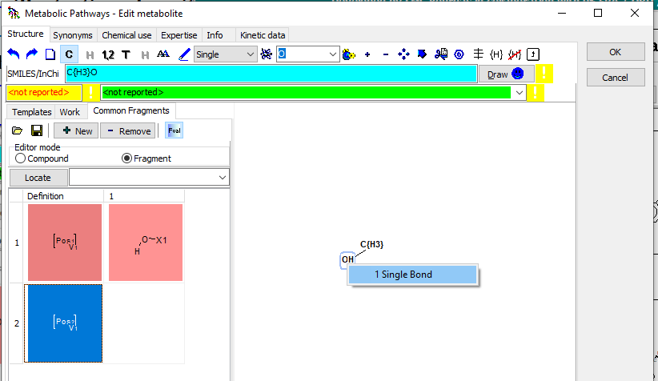
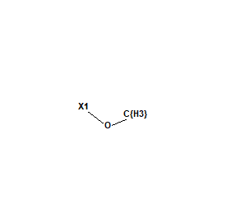
Example 1 – illustration of positional type fragment for generating positional isomers of metabolite
Definition of the common fragment (3)
19
22
20
Press Fval button to define bond for connection of the fragment to the scaffold
Right-click over the O-atom
Select Single bond
A bond appears labeled with X1
21

Slide 40
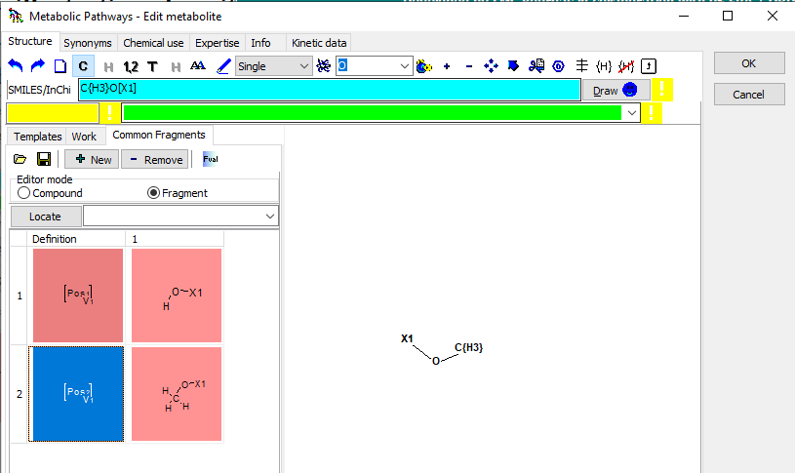
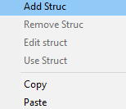
Example 1 – illustration of positional type fragment for generating positional isomers of metabolite
Definition of the common fragment (4)
24
Perform right-clicks over the name of the positional fragment and press on Add struc
The fragment appears in the library
23

Slide 41

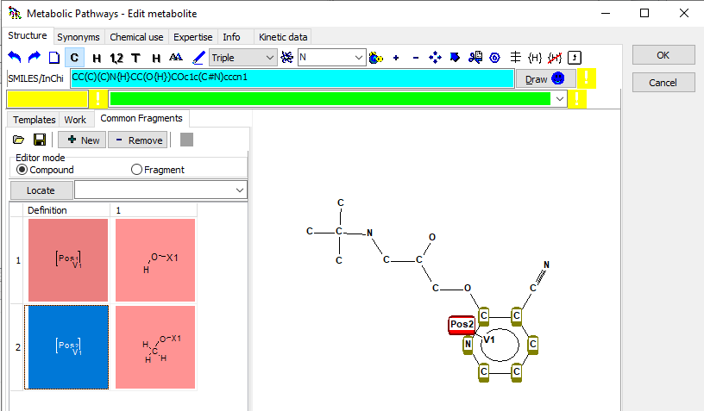
Example 1 – illustration of positional type fragment for generating positional isomers of metabolite
Attachment of fragment to the scaffold (1)
28
29
25
27
Switch to Compound mode
Left mouse click over the positional fragment
Hold the mouse and drag the fragment. Move it over the benzene ring. The atoms should become green highlighted
Check Single connect
Add single (i.e. hydroxyl group is attached once at the benzene ring). Finally press OK button
26

Slide 42
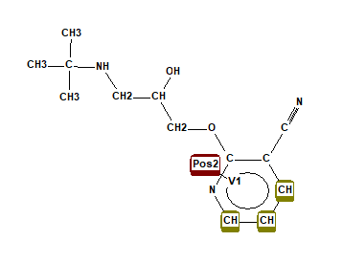
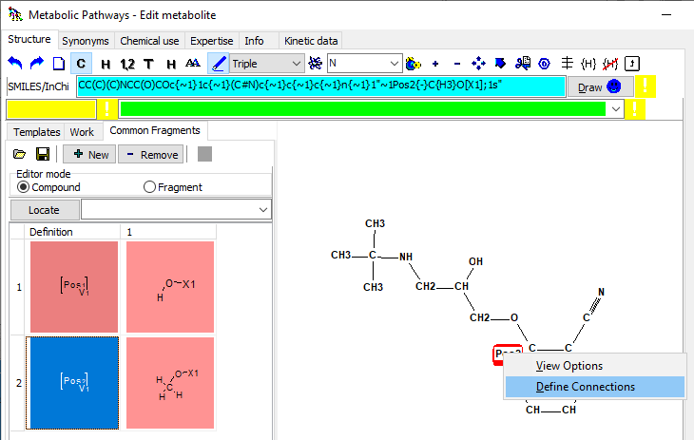
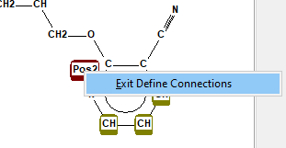
Example 1 – illustration of positional type fragment for generating positional isomers of metabolite
Attachment of fragment to the scaffold (2)
31
31
31
31
31
32
33
30
Perform right click over the name of the position fragment Pos2 and select Define connections
Left click over the atoms whether the fragment couldn’t be connected.
Only the atoms whether the methoxy group could be bonded should be highlighted in green
Right-click over the name of he fragment and select Exit Define Connections

Slide 43
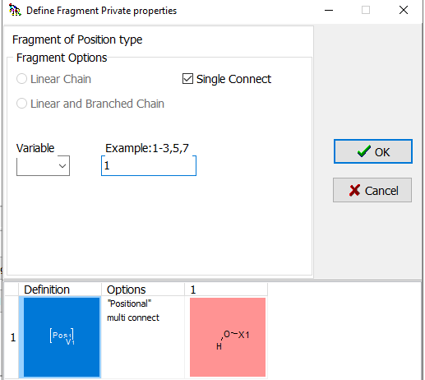
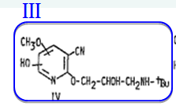
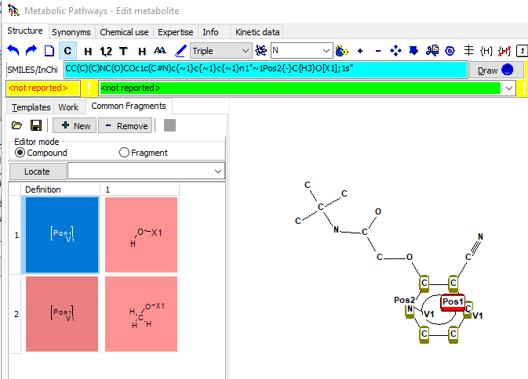
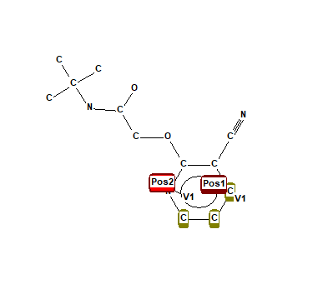
Example 1 – illustration of positional type fragment for generating positional isomers of metabolite
Attachment of fragment to the scaffold (3)
36
37
34
38
35
Because metabolite III contains hydroxyl and methoxy group simultaneously please follow the steps to add the hydroxyl group:
Perform right click over the name of the fragment Pos1 including the hydroxyl group
Hold and drag to the benzene ring, release the mouse to glue the fragment to the scaffold
Select Single connect
Add single repetition. Press OK button
Right click over the name of the fragment Pos1 and select Define connections, left click over the atoms to which the hydroxyl group could be connected– see 30 and 32 on previous slide

Slide 44
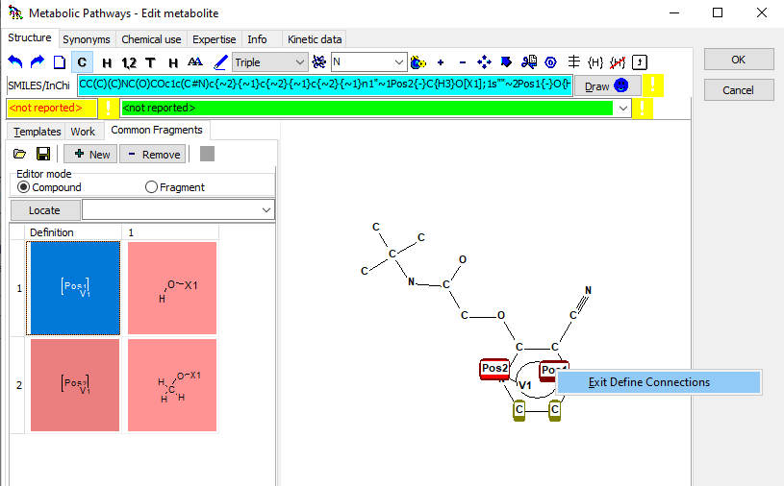
Example 1 – illustration of positional type fragment for generating positional isomers of metabolite
Attachment of fragment to the scaffold (4)
40
39
Right-click over the name of he fragment and select Exit Define Connections
Click OK

Slide 45



Example 1 – illustration of positional type fragment for generating positional isomers of metabolite
44
Visualization of generated metabolites
41
42
43
Click Post Changes
Metabolite II appears in the map
Right-click over the metabolite and select Display individual structures
All possible positional isomers are visualized

Slide 46
Example 1 – illustration of positional type fragment for generating positional isomers of metabolite
Documented metabolic map
III
Metabolite III is ready
Vickers. S et.al. The metabolic disposition of (S)-2-(3-tert-Butylamino-2-hydroxypropoxy)-3-cyanopyridine in rats, dogs, and humans. Drug Metabolism and Disposition, Vol,8, No3. 1980.

Slide 47

Example 2 – illustration of positional type fragment for generating positional isomers of metabolite
Documented metabolic map
Metabolite I
For definition of metabolite I the already defined positional fragment including hydroxyl group will be used and a new one will be created.
Nakagawa et.al. Biotransformation and cytotoxic effects of hydroxychavicol, an intermediate of safrole metabolism, in isolated rat hepatocytes. Chemico-Biological Interactions 180 (2009) 89–97

Slide 48


Example 2 – illustration of positional type fragment for generating positional isomers of metabolite
Definition of the common fragment for Metabolite I (1)
2
1
3
Select parent chemical
Click to generate child
Click Edit product
A new fragment containing O-sulfate group will be created. For this purpose already available structures in the Work panel will be used (see next slides)

Slide 49


Example 2 – illustration of positional type fragment for generating positional isomers of metabolite
Definition of the common fragment for Metabolite I (2)
7
6
8
4
5
9
3
Switch to Common fragments section
Select Fragment
Add new Positional fragment.
Add name,
Select single bond and
click OK

Slide 50

Example 2 – illustration of positional type fragment for generating positional isomers of metabolite
Definition of the common fragment for Metabolite I (3)
10
12
Click on Work section
Select Sulfate group
The sulfate group automatically appears on the blank space
11

Slide 51

Example 2 – illustration of positional type fragment for generating positional isomers of metabolite
Definition of the common fragment for Metabolite I (4)
13
14
15
Switch to Common fragments
Click on Fval to add connection to the fragment
Right-click over the O-atom and select Single bond
Right-click over the name of the positional fragment and select Add Struc
16

Slide 52



Example 2 – illustration of positional type fragment for generating positional isomers of metabolite
Definition of the common fragment for Metabolite I (5)
20
21
17
19
18
Switch to Compound
Erase the two O-atoms using the scissors
Take the positional fragment containing hydroxyl group
Hold and drag to the benzene ring.
Specify single repetition and single connect. Click OK

Slide 53


Example 2 – illustration of positional type fragment for generating positional isomers of metabolite
Attachment of fragment to the scaffold
25
24
22
Right click over the name of the positional fragment and specify the atoms to which the hydroxyl group could be connected
Take the positional fragment with sulfate group and repeat steps 20-21
Finally perform right-click over the name of the fragment and click Exit Define Connections
Click OK
23

Slide 54




Example 2 – illustration of positional type fragment for generating positional isomers of metabolite
Visualization of generated isomeric forms
26
27
Click Post Changes
Perform right-click over the metabolite and select Display individual structures
54

Slide 55
Examples
Example 3 - illustration of enumeration type fragment for searching specific metabolites in metabolic maps
Enumeration
Example 4 - illustration of chain type fragment for searching homologous series of metabolites
Chain
Bond migration
Slides with detailed instructions how to create and use common fragments for searching purposes are forthcoming
Cyclic
Positional
Hetero
Positional Chain

Slide 56
Example 3 – illustration of enumeration type fragment for searching of metabolites
Example 3 - illustration of enumeration type fragment for searching specific metabolites in metabolic maps
Enumeration
Chain
Bond migration
Aim: To find all source chemicals in the documented map having aldehyde group attached to the aliphatic chain
Cyclic
Positional
Hetero
Positional Chain

Slide 57


Example 3 – illustration of enumeration type fragment for searching of metabolites
Definition of the criteria for searching (1)
3
1
2
4
Open the map from which you want to search
Click Search
Select Transformations from the drop-down menu
Select Structure section
Click Structure drawing button

Slide 58


Example 3 – illustration of enumeration type fragment for searching of metabolites
Definition of the criteria for searching (2)
7
5
6
9
10
8
11
Click the Common fragment section
Switch to Fragment mode
Click New button to create new type fragment
Select Enumeration type
Add name of the fragment (or leave it as it is)
Add single bond
Click to OK button

Slide 59



Example 3 – illustration of enumeration type fragment for searching of metabolites
Definition of the criteria for searching (3)
13
16
18
21
14
22
17
23
15
12
20
19
Enumeration type fragment appears in the library
Click on the button C to display all Carbon atoms in the scaffold
Take the double bond
Hold and drag on the blank space to drawn it
Take the O-atom by clicking on the button
Put the O-atom at the end of the double bond
Click on the button for the definition of explicit hydrogen
Click over the C-atom to make one of the free atom explicit hydrogen
Click over the name of the fragment
Click on Fval button
Right-click on C atom and select Single bond
Perform right click and select Add Struc

Slide 60



Example 3 – illustration of enumeration type fragment for searching of metabolites
Definition of the criteria for searching (4)
25
24
27
28
26
29
Stitch to Compound section. Now we will define the scaffold
Take the single bond
Drag two times to drawn two single bonds
Left-click over the Enum fragment
Hold and release it over the first C-atom.
Click OK

Slide 61

Example 3 – illustration of enumeration type fragment for searching of metabolites
Definition of the criteria for searching (5)
30
32
31
Select Source structures
Click Enter Clause
Double click over the Q1 to execute it

Slide 62


Example 3 – illustration of enumeration type fragment for searching of metabolites
Display of identified maps
33
34
34
Click on tab “as transformations” to see the identified source chemicals
The identified source chemicals have aldehyde group in their structure

Slide 63
Example 4 – illustration of chain type fragment for searching of metabolites
Enumeration
Example 4 - illustration of chain type fragment for searching homologous series of metabolites
Chain
Bond migration
Cyclic
Positional
Aim: To find all chemicals in the documented map having benzylic ester with aliphatic chain length between one and four C-atoms
Hetero
Positional Chain

Slide 64


Example 4 – illustration of chain type fragment for searching of metabolites
Definition of the criteria for searching (1)
1
3
2
4
4
Open the map from which you want to search
Click Search
Select Chemicals from the drop-down menu
Select Structure section
Click on Structure drawing button

Slide 65


Example 4 – illustration of chain type fragment for searching of metabolites
Definition of the criteria for searching (2)
5
7
10
9
6
8
11
Click on Common fragments
Select Fragment option
Click New fragment
Select Chain type
Add name of the fragment (or keep it as it is)
Select single bond
Click OK button

Slide 66

Example 4 – illustration of chain type fragment for searching of metabolites
Definition of the criteria for searching (3)
13
12
14
15
The Chain type appears in the library
Select C-atom
Put it on the blank space
Right-click over it and select SP3 –hybridization sp3
Click OK
16

Slide 67



Example 4 – illustration of chain type fragment for searching of metabolites
Definition of the criteria for searching (4)
17
18
21
19
22
20
Click on the C button, to display the C atoms
Click on Fval
Right-click over the C atom
Select Single bond Chain Entrance
Left click over the C atom, select Single bond Chain Exit
Repeat step 21 twice to create 3 single bonds labeled with X1

Slide 68



Example 4 – illustration of chain type fragment for searching of metabolites
Definition of the criteria for searching (5)
25
28
27
24
26
23
Right click over the positional fragment
Click Add Struc
Click on Compound mode
Drawn benzoic acid or paste the SMILES in the SMILES filed: c1c(C(=O)O)cccc1
Left click over the chain fragment
Hold and move the cursor to the O-atom from the carboxylic group. Release left button to glue the V1 connection to the O atom

Slide 69



Example 4 – illustration of chain type fragment for searching of metabolites
Definition of the criteria for searching (6)
33
35
32
31
29
34
30
36
Select Linear and Branched Chain. This means that both type of chains could be found
Add range from 1 to 4
Click OK
Now the free bond need to be completed with terminal Carbon atom with 3 explicit hydrogen atoms
Select pencil to drawn the single bond
Drag once to create single bond
Click on explicit button
Press 3 times over the C-atom, to define that it is completed with H atoms

Slide 70


Example 4 – illustration of chain type fragment for searching of metabolites
Visualization of the defined chemicals
38
39
40
37
Click on Enter Clause
Double click over Q1 to execute the clause
The list with identified compounds are found and could be seen
The identified compounds met the defined criteria

