Slide 1
MetaPath Platform:
Introducing kinetic data
Laboratory of Mathematical Chemistry
University “Prof. As. Zlatarov” Bourgas, Bulgaria
June, 2022

Slide 2
Outlook
Types of data previously stored in MetaPath platform
The newly added data layer – kinetic data
Information included in the kinetic data layer
Association between kinetic data and other data layers
User interface
Searching kinetic data
Notes:
This is the structure of my talks.
First ‘Why we decided to model skin sensitization?’
Next I will talk about the data used, the mechanism of modeled phenomena and developed model, results and finally future work.

Slide 3
Outlook
Types of data previously stored in MetaPath platform
The newly added data layer – kinetic data
Information included in the kinetic data layer
Association between kinetic data and other data layers
User interface
Searching kinetic data
Notes:
This is the structure of my talks.
First ‘Why we decided to model skin sensitization?’
Next I will talk about the data used, the mechanism of modeled phenomena and developed model, results and finally future work.

Slide 4
MetaPath platform
Storage and management of documented metabolism
Types of data (layers) previously stored in MetaPath
Chemicals data (chemicals layer) - chemical structure, chemical names, regulatory identifiers
Transformations data (transformations layer) – pairs parent/metabolite, enzymes (if any), hierarchy of observed transformations organized in metabolic trees
Experimental details (experiments layer) – study specifics such as treated species, experimental systems, organs/tissues, doses, etc.
Associations between transformations/metabolites and experimental details (associations layer) – shows differences in metabolism due to study variations

Slide 5
Outlook
Types of data previously stored in MetaPath platform
The newly added data layer – kinetic data
Information included in the kinetic data layer
Association between kinetic data and other data layers
User interface
Searching kinetic data
Notes:
This is the structure of my talks.
First ‘Why we decided to model skin sensitization?’
Next I will talk about the data used, the mechanism of modeled phenomena and developed model, results and finally future work.

Slide 6
MetaPath platform
Storage and management of documented metabolism
The newly added data layer – kinetic data
Development funded by Unilever, remained in private domain for several years
EFSA funded migration from private to public domain
The version is ready, waits for approval from EFSA
Kinetic data provide information about the kinetics of the metabolic transformations
The layer includes values (half-life, Km, Vmax, clearance) and/or time series (parent / metabolite quantity as a function of time)
There are two possible sets of values/time series:
in vitro – half-life, Km, Vmax, clearance, protein content, activity rate
in vivo – half-life, area under curve (AUC), AUC time, clearance

Slide 7
Outlook
Types of data previously stored in MetaPath platform
The newly added data layer – kinetic data
Information included in the kinetic data layer
Association between kinetic data and other data layers
User interface
Searching kinetic data
Notes:
This is the structure of my talks.
First ‘Why we decided to model skin sensitization?’
Next I will talk about the data used, the mechanism of modeled phenomena and developed model, results and finally future work.

Slide 8
MetaPath platform
Storage and management of documented metabolism
The kinetic data and other data layers
Kinetic data is associated with the chemical (parent / metabolite)
Kinetic data is also associated with the experimental conditions (treatment groups) – in vivo/in vitro, dose, experimental system, etc.
Any set of kinetic data must be associated with a combination metabolite + treatment group

Slide 9
Outlook
Types of data previously stored in MetaPath platform
The new data layer – kinetic data
Information included in the kinetic data layer
Association between kinetic data and other data layers
User interface
Searching kinetic data
Notes:
This is the structure of my talks.
First ‘Why we decided to model skin sensitization?’
Next I will talk about the data used, the mechanism of modeled phenomena and developed model, results and finally future work.

Slide 10
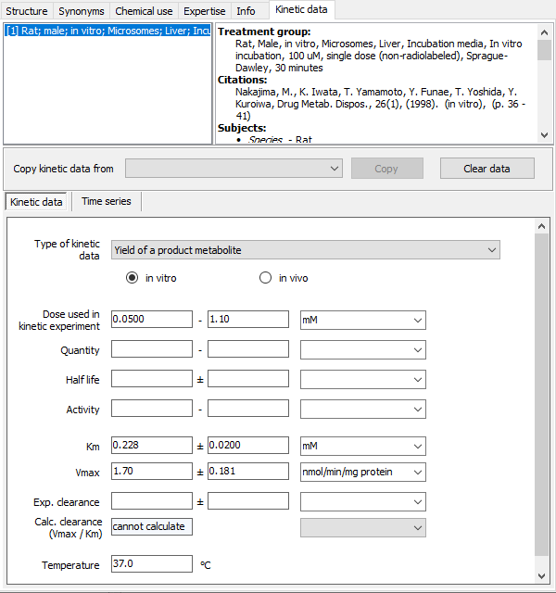
MetaPath platform
Storage and management of documented metabolism
The kinetic data on the user interface (example #1)
Kinetic values associated with metabolite + treatment group
Treatment group
Kinetic values

Slide 11
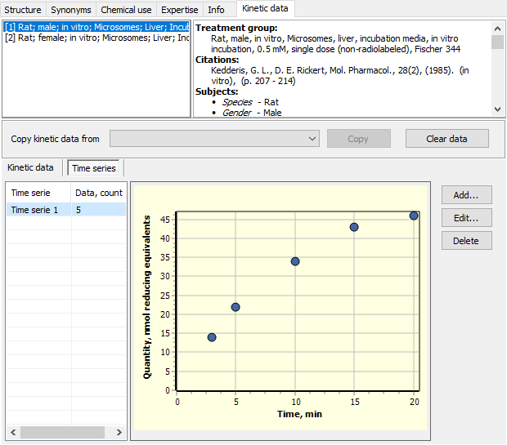
MetaPath platform
Storage and management of documented metabolism
The kinetic data on the user interface (example #2)
Time serie associated with metabolite + treatment group
Treatment group
Time serie

Slide 12
Outlook
Types of data previously stored in MetaPath platform
The newly added data layer – kinetic data
Information included in the kinetic data layer
Association between kinetic data and other data layers
User interface
Searching kinetic data
Notes:
This is the structure of my talks.
First ‘Why we decided to model skin sensitization?’
Next I will talk about the data used, the mechanism of modeled phenomena and developed model, results and finally future work.

Slide 13
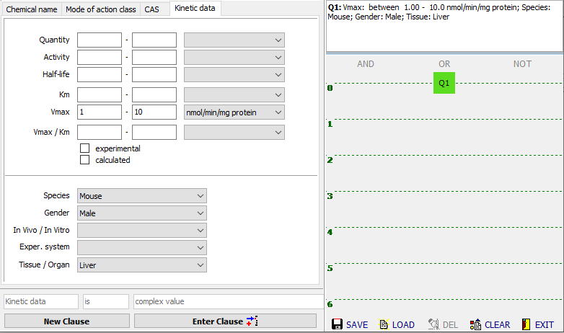
MetaPath platform
Storage and management of documented metabolism
Searches based on kinetic data
Searches for metabolites meeting kinetic data criteria
Experimental details can be used as additional filter
Search criteria based on kinetic data
Additional filter based on experimental details

Slide 14
Thank you for your attention
Notes:
This is the structure of my talks.
First ‘Why we decided to model skin sensitization?’
Next I will talk about the data used, the mechanism of modeled phenomena and developed model, results and finally future work.

