Slide 1
Software Licensing
CATALOGIC
LMC, 2022

Slide 2
Activation
Software activation requires only a valid Product Key
Product Key
User details

Slide 3

Product Key
Each Product Key
  has an expiration date
  activates one product, e.g., CATALOGIC
  activates one machine
  grants a one-week grace period after expiration
Unlocks a single machine
7458B6CF-5100-4E53-8264-D6EB173E240C

Slide 4
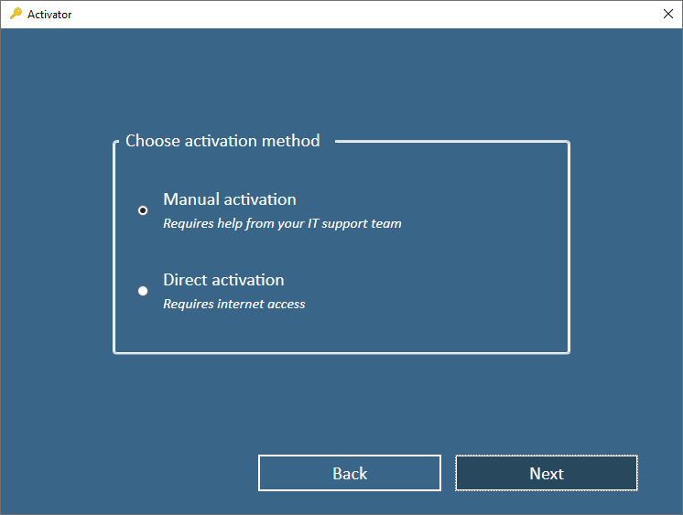
Activation methods
There are two activation methods, the “Manual” one is preferred
Automatic
automatically downloads the license
Manual
the user downloads the license

Slide 5
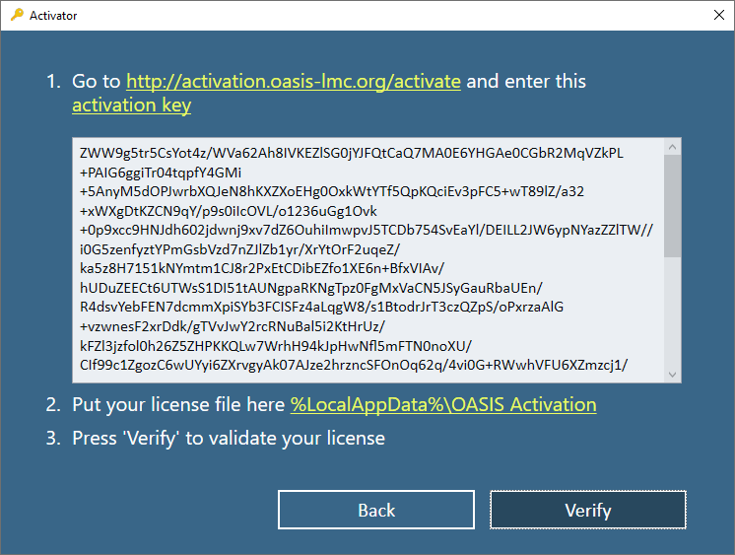
The Activation Key contains
Follow the instructions to download your license file
Product Key
Product ID
Machine info
User details

Slide 6
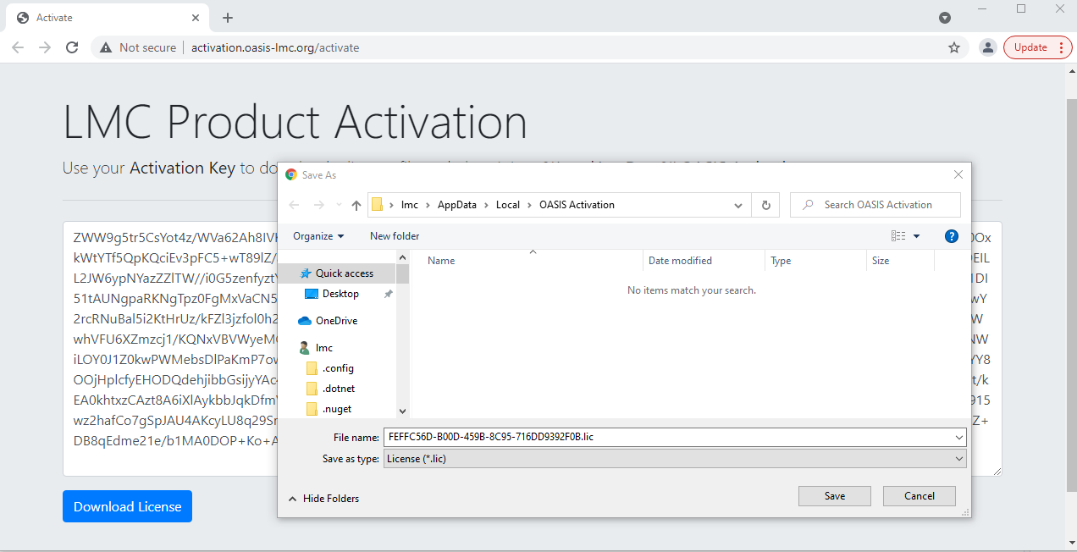

Slide 7
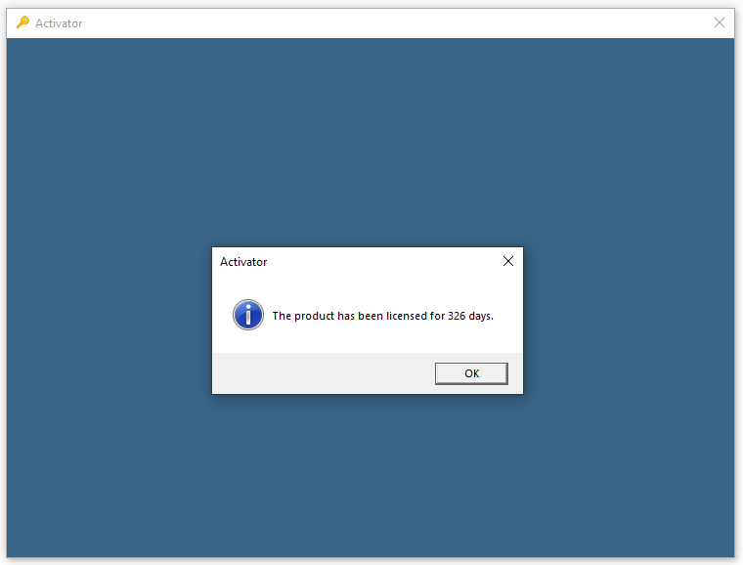
Once activated, the software could be used without any restrictions

Slide 8
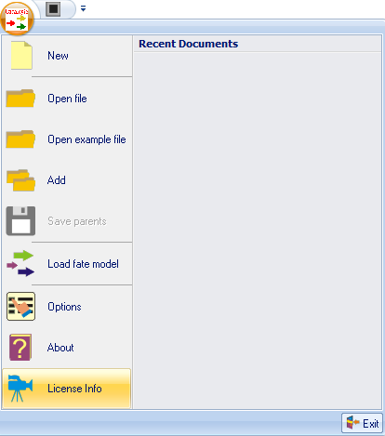
You can see the exact expiration date of your license

Slide 9
Troubleshooting
Make sure you have installed the required .NET runtime
The following error indicates a problem with the WMI configuration on your machine.
Please ask your IT team to troubleshoot the Windows Management Instrumentation.
To assist you further, we have included a batch script “InstallDir\Activator\Troubleshoot\RepairWMI.bat”
which is very likely to fix the issue.

Slide 10
Thank you!

