Slide 1
QSAR Toolbox
Customized search (Query Tool)
Laboratory of Mathematical Chemistry,
Bourgas University “Prof. Assen Zlatarov”
Bulgaria

Slide 2
Outlook
What is Query Tool?
Environmental fate - examples (BCF, BOD)
Human health hazard - examples (AMES and Carcinogenicity)
2
Notes:
2
2

Slide 3
Outlook
What is Query Tool?
Environmental fate - examples (BCF, BOD)
Human health hazard - examples (AMES and Carcinogenicity)
3
Notes:
3
3

Slide 4
Customized search (Query Tool)
What is Customized search ?
Goal:
Searching for chemicals by applying different criteria such as:
chemical identifiers,
sub fragments,
phys-chem properties,
experimental data,
profilers
4
Notes:
4
4

Slide 5
Customized search (Query Tool)
Types customized search ?
Chemical identifier
CAS
Name
Data
Experimental data accompanying with(out) metadata
Parameter
2D parameters
3D parameters
Extended
Profiling
Substructure
Similarity
5
Notes:
5
5

Slide 6
Outlook
What is Query Tool?
Environmental fate - examples (BCF, BOD)
Human health hazard - examples (AMES and Carcinogenicity)
6
Notes:
6
6

Slide 7
Customized search (Query Tool)
Environmental search examples (BOD and BCF)
Example 1:
Biodegradable chemicals which are not bioaccumulative
(BOD >60% and BCF ≤ 2000 L/kg wet)
7
Notes:
7
7

Slide 8
Customized search (Query Tool)
Environmental search examples (BOD and BCF)
Example 1: Biodegradable chemicals which are not bioaccumulative (BOD >60% and BCF ≤ 2000 L/kg wet)
Procedure of defining queries:
Selection of databases
Bioaccumulation Canada
BCF fish CEFIC LRI
Bioconcentration NITE
Biodegradation NITE
Selection of databases with BCF and BOD data
8
Notes:
8
8

Slide 9
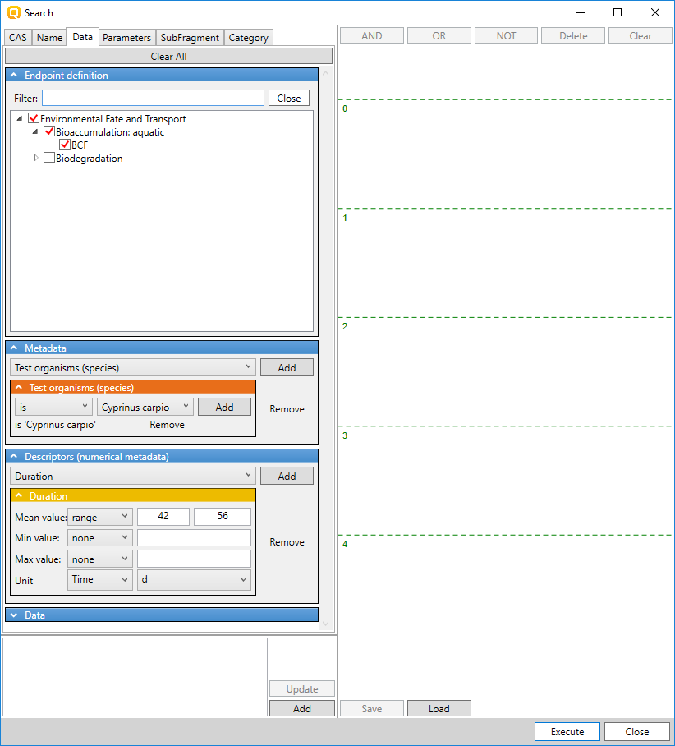
Customized search (Query Tool)
Environmental search examples (BOD and BCF)
Example 1: Biodegradable chemicals which are not bioaccumulative (BOD >60% and BCF ≤ 2000 L/kg wet)
Procedure of defining queries:
Selection of databases
Defining queries:
Endpoint: BCF
Species: C.carpio
Duration: 42 ÷ 56 days
Data: BCF < 2000 L/kg wet
Endpoint: BCF
Species: C.carpio
Duration: 42÷56d
9
Notes:
9
9

Slide 10
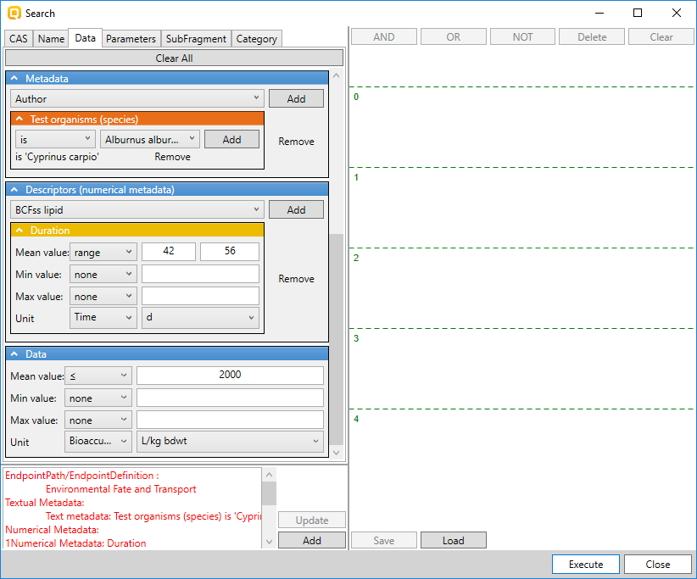
Customized search (Query Tool)
Environmental search examples (BOD and BCF)
Example 1: Biodegradable chemicals which are not bioaccumulative (BOD >60% and BCF ≤ 2000 L/kg wet)
Procedure of defining queries:
Selection of databases
Defining queries:
Endpoint: BCF
Species: C.carpio
Duration: 42 ÷ 56 days
Data: BCF < 2000 L/kg wet
BCF data < 2000 L/kg wet
10
Notes:
10
10

Slide 11
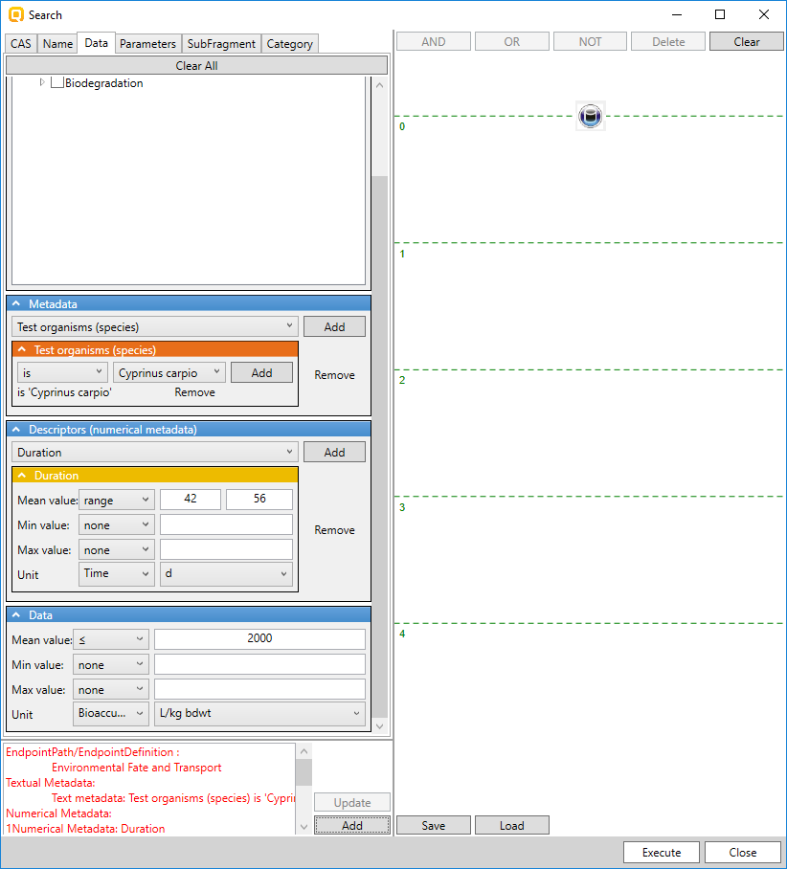
Customized search (Query Tool)
Environmental search examples (BOD and BCF)
Example 1: Biodegradable chemicals which are not bioaccumulative (BOD >60% and BCF ≤ 2000 L/kg wet)
Procedure of defining queries:
Selection of databases
Defining queries:
Endpoint: BCF
Species: C.carpio
Duration: 42 ÷ 56 days
Data: BCF < 2000 L/kg wet
Defined query
11
Notes:
11
11

Slide 12
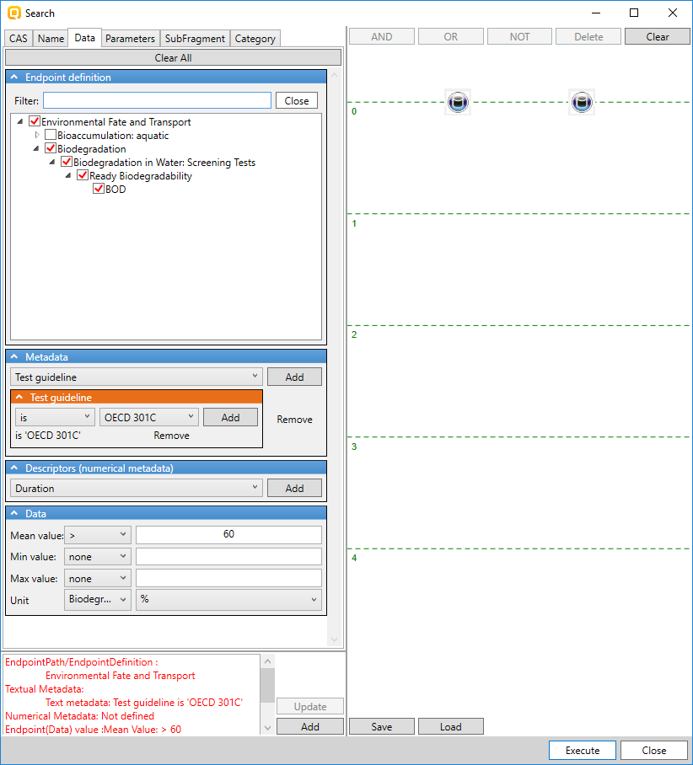
Customized search (Query Tool)
Environmental search examples (BOD and BCF)
Example 1: Biodegradable chemicals which are not bioaccumulative (BOD >60% and BCF ≤ 2000 L/kg wet)
Procedure of defining queries:
Selection of databases
Defining queries:
Endpoint: BOD
Guideline: OECD 301C
Data: BOD > 60%
Endpoint BOD
Guideline: OECD 301C
BOD data > 60%
12
Notes:
12
12

Slide 13
Customized search (Query Tool)
Environmental search examples (BOD and BCF)
Example 1: Biodegradable chemicals which are not bioaccumulative (BOD >60% and BCF ≤ 2000 L/kg wet)
Procedure of defining queries:
Selection of databases
Defining queries:
Endpoint: BOD
Guideline: OECD 301C
Data: BOD > 60%
Defined query
13
Notes:
13
13

Slide 14
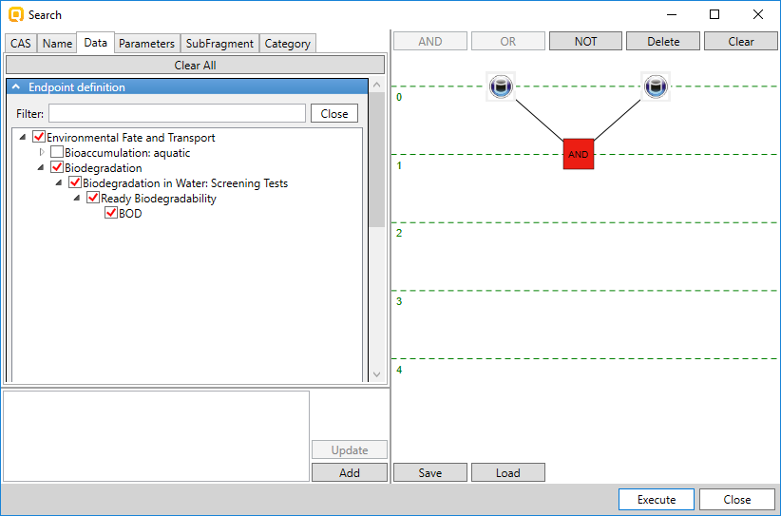
Customized search (Query Tool)
Environmental search examples (BOD and BCF)
Example 1: Biodegradable chemicals which are not bioaccumulative (BOD >60% and BCF ≤ 2000 L/kg wet)
Procedure of defining queries:
Selection of databases
Defining queries
Combining queries by logical operator
Queries are logically AND-ed
Possibility to execute separate query and logical combination
Save and load the defined query
14
Notes:
14
14

Slide 15
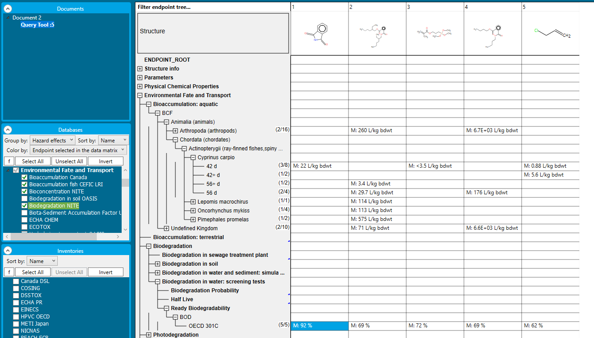
Customized search (Query Tool)
Environmental search examples (BOD and BCF)
Example 1: Biodegradable chemicals which are not bioaccumulative (BOD >60% and BCF ≤ 2000 L/kg wet)
Results: 5 chemicals meeting the criteria of the defined queries
BCF <2000 L/kg wet
BOD > 60%
15
Notes:
15
15

Slide 16
Customized search (Query Tool)
Environmental search examples (BOD and BCF)
Example 2:
Correspondence between lipophilicity and bioaccumulation (BCF). Not all lipophilic chemicals are bioaccumulative
Query: lipophilic (log Kow>4.2) and not bioacumulative chemicals (BCF<1000 L/kg wet)
16
Notes:
16
16

Slide 17
Customized search (Query Tool)
Environmental search examples (BOD and BCF)
Example 2: Query is log Kow > 4.2 and not bioacumulative data (BCF < 1000 L/kg wet)
Procedure of defining queries:
Selection of databases
Bioaccumulation Canada
BCF fish CEFIC LRI
Bioconcentration NITE
Biodegradation NITE
Selection of databases with BCF and BOD data
17
Notes:
17
17

Slide 18
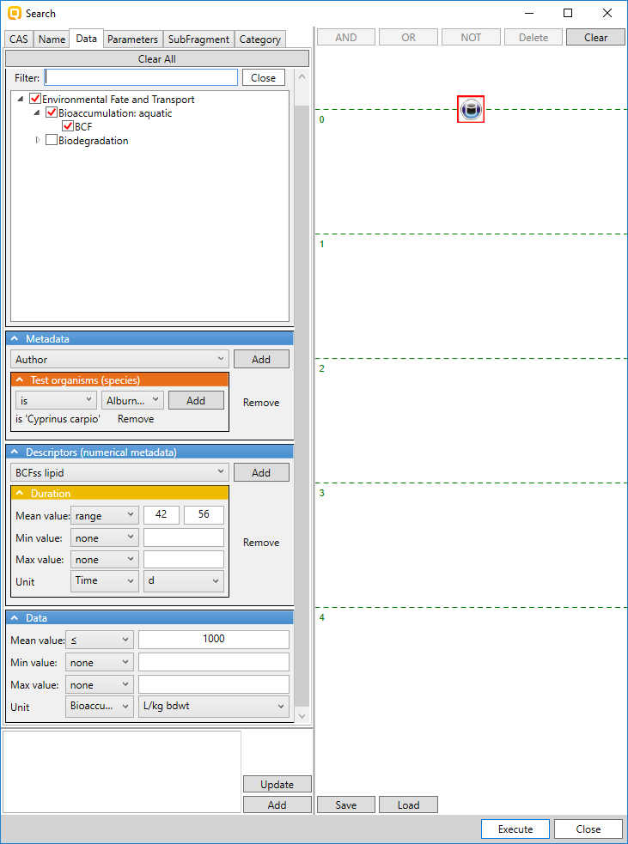
Customized search (Query Tool)
Environmental search examples (BOD and BCF)
Example 2: Query is log Kow > 4.2 and not bioacumulative data (BCF < 1000 L/kg wet)
Procedure of defining queries:
Selection of databases
Defining queries:
Endpoint: BCF
Species: C.carpio
Duration: 42 ÷ 56 days
Data: BCF < 1000 L/kg wet
Defined query
Endpoint: BCF
Species: C.carpio
Duration: 42÷56d
BCF data < 1000 L/kg wet
18
Notes:
18
18

Slide 19
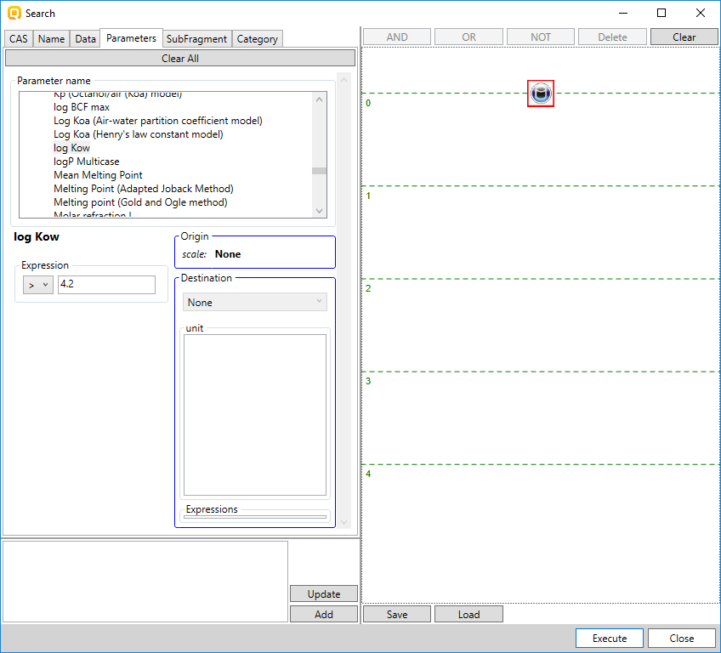
Customized search (Query Tool)
Environmental search examples (BOD and BCF)
Example 2: Query is log Kow > 4.2 and not bioacumulative data (BCF < 1000 L/kg wet)
Procedure of defining queries:
Selection of databases
Defining queries:
2D parameters:
logKow >4.2
Defined query
2D parameter: logKow
Threshold
19
Notes:
19
19

Slide 20
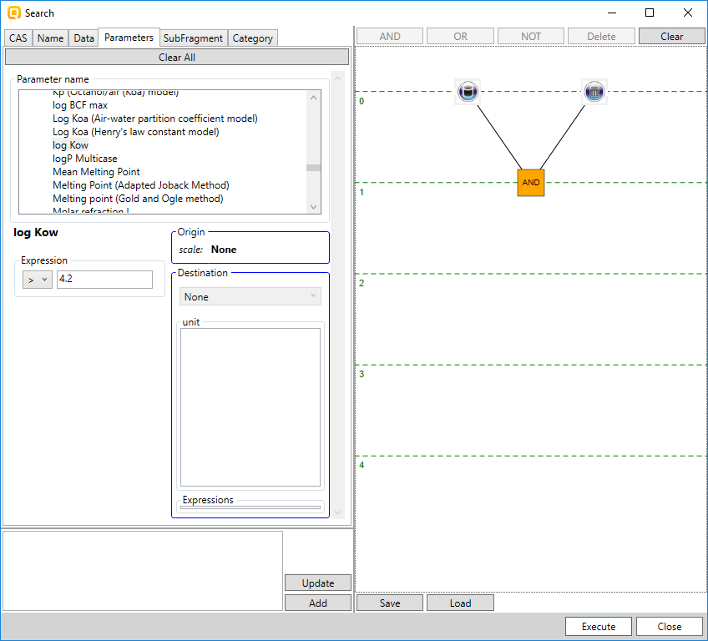
Customized search (Query Tool)
Environmental search examples (BOD and BCF)
Example 2: Query is log Kow > 4.2 and not bioacumulative data (BCF < 1000 L/kg wet)
Procedure of defining queries:
Selection of databases
Defining queries:
Combining queries by logical operator
Queries are logically AND-ed
20
Notes:
20
20

Slide 21
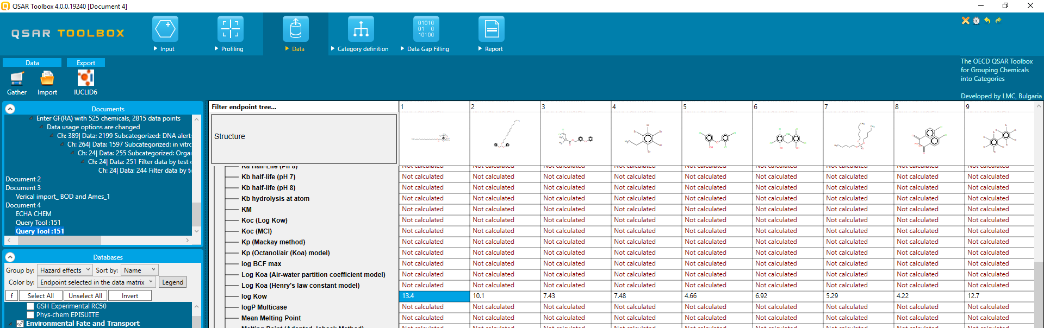
Customized search (Query Tool)
Environmental search examples (BOD and BCF)
Example 2: Query is log Kow > 4.2 and not bioacumulative data (BCF < 1000 L/kg wet)
Results: 151 chemicals meeting the criteria of the defined queries
Log Kow > 4.2
BCF <1000 L/kg wet
21
Notes:
21
21

Slide 22
Outlook
What is Query Tool?
Environmental fate - examples (BCF, BOD)
Human health hazard - examples (AMES and Carcinogenicity)
22
Notes:
22
22

Slide 23
Customized search (Query Tool)
Human health hazard examples (AMES, Carcinogenicity)
Example:
Mutagenic chemicals (AMES positive) which are not carcinogenic
23
Notes:
23
23

Slide 24
Customized search (Query Tool)
Human health hazard examples (AMES, Carcinogenicity)
Example: Mutagenic chemicals (AMES positive) which are not carcinogenic
Procedure of defining queries:
Selection of databases
Carcinogenicity potency DB CPDB
Carcinogenicity&mutagenicity ISSCAN
Bacterial ISSTY
Genotoxicity OASIS
Toxicity Japan
Selection of databases with Carcinogenicity and AMES data
24
Notes:
24
24

Slide 25
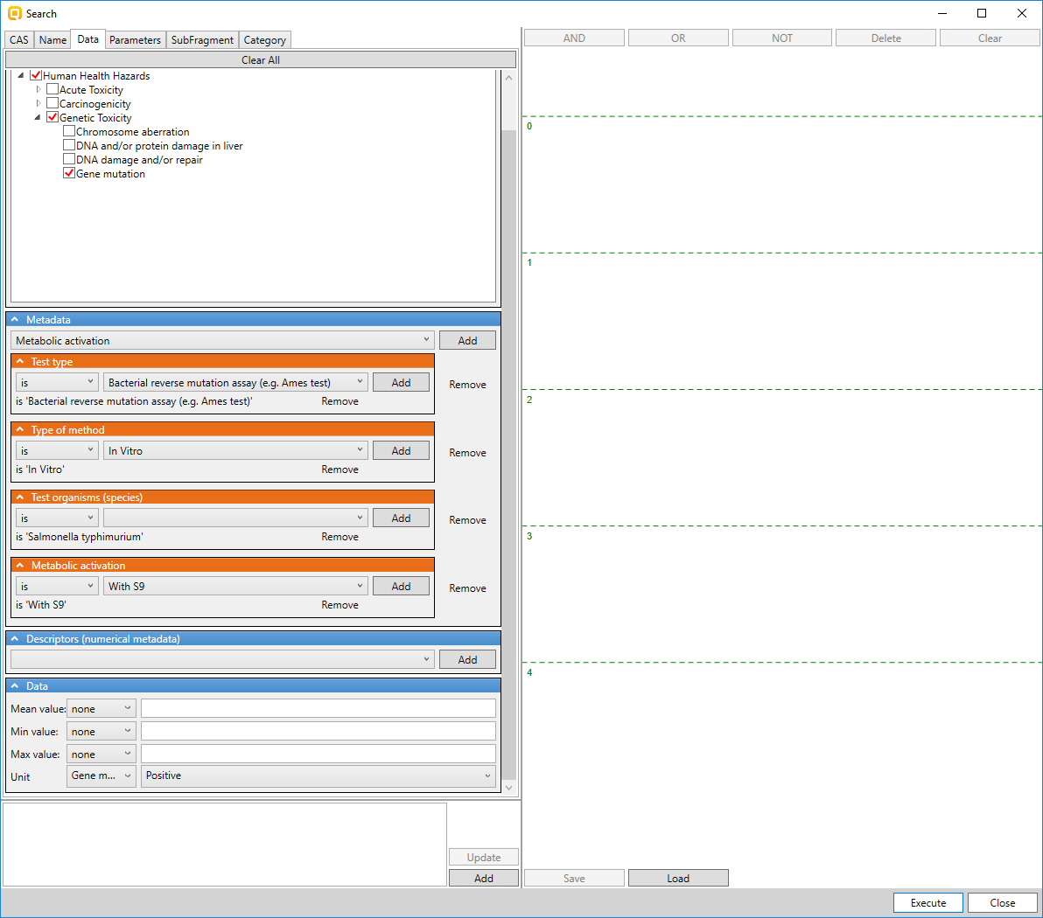
Customized search (Query Tool)
Human health hazard examples (AMES, Carcinogenicity)
Example: Mutagenic chemicals (AMES positive) which are not carcinogenic
Procedure of defining queries:
Selection of databases
Defining queries:
AMES positive
Endpoint: Gene mutation
Test type: Bacterial reverse mutation assay (e.g. Ames)
Type of method: In vitro
Species: S. typhimurium
Metabolism: with S9
Scale: Gene mutation I
Data: Positive
Endpoint: Gene mutation
Test type: Ames test
Type of method: In vitro
Species: S.typhimurium
Activation: with S9
Scale: gene mutation I
Data: positive
25
Notes:
25
25

Slide 26
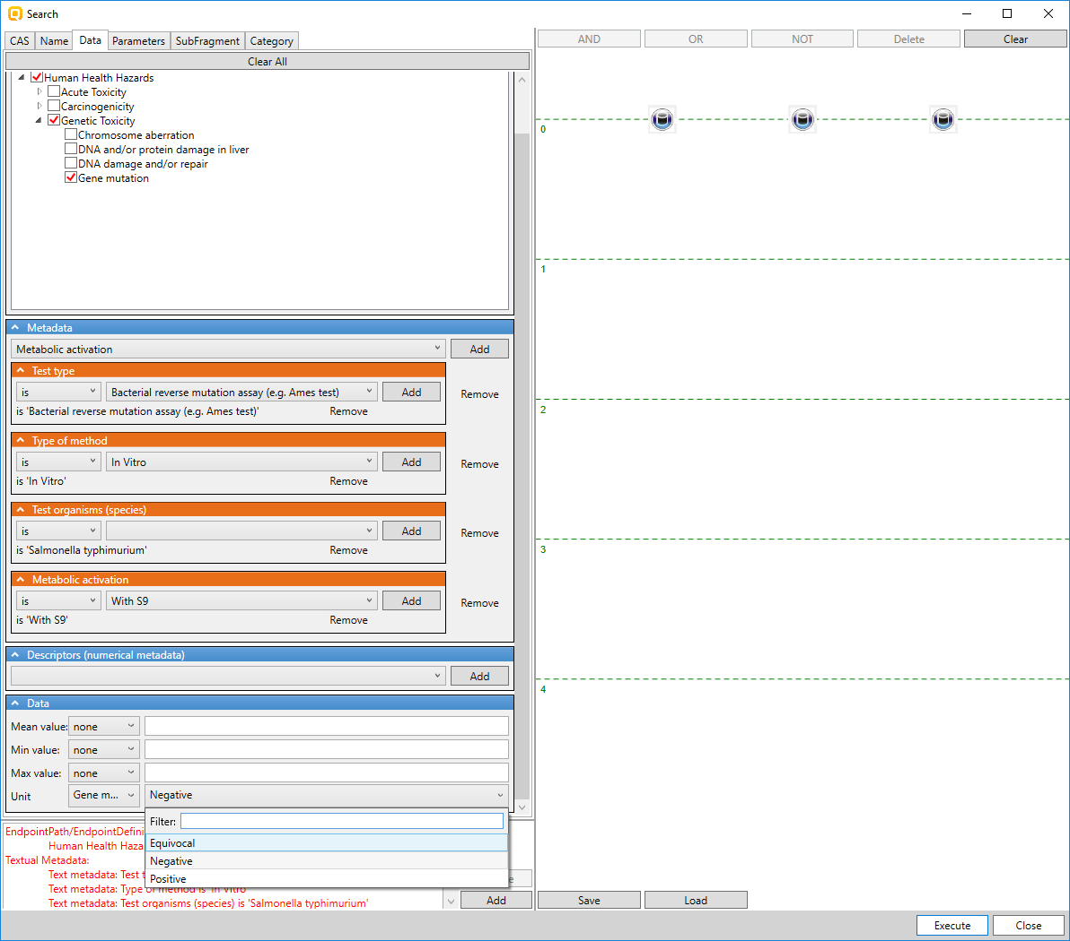
Customized search (Query Tool)
Human health hazard examples (AMES, Carcinogenicity)
Example: Mutagenic chemicals (AMES positive) which are not carcinogenic
Procedure of defining queries:
Selection of databases
Defining queries:
AMES positive
Endpoint: Gene mutation
Test type: Bacterial reverse mutation assay (e.g. Ames)
Type of method: In vitro
Species: S. typhimurium
Metabolism: with S9
Scale: Gene mutation I
Data: Positive
Define restrictive condition
Queries associated with negative and equivocal data
Define restrictions: search for chemicals with positive data only. Chemicals with negative and equivocal data are excluded from query (shown on next slide)
26
Notes:
26
26

Slide 27
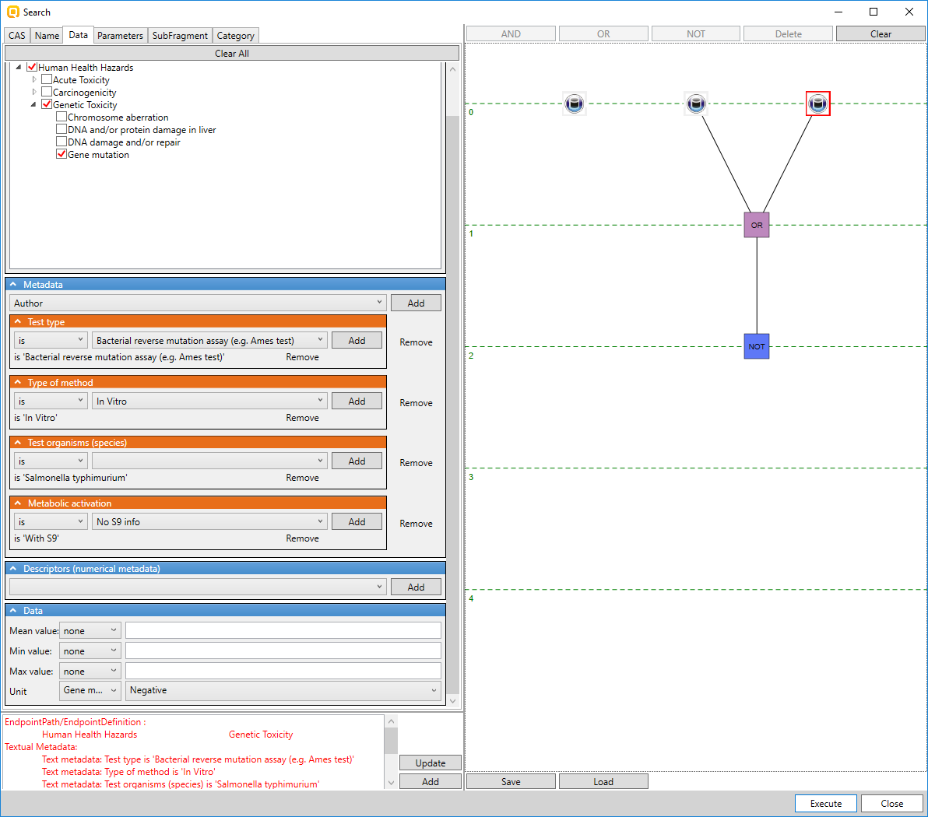
Customized search (Query Tool)
Human health hazard examples (AMES, Carcinogenicity)
Example: Mutagenic chemicals (AMES positive) which are not carcinogenic
Procedure of defining queries:
Selection of databases
Defining queries:
AMES positive
Endpoint: Gene mutation
Test type: Bacterial reverse mutation assay (e.g. Ames)
Type of method: In vitro
Species: S. typhimurium
Metabolism: with S9
Scale: Gene mutation I
Data: Positive
Negating queries
Queries defining negative and equivocal data are logically OR-ed and then negated (excluding from search)
27
Notes:
27
27

Slide 28
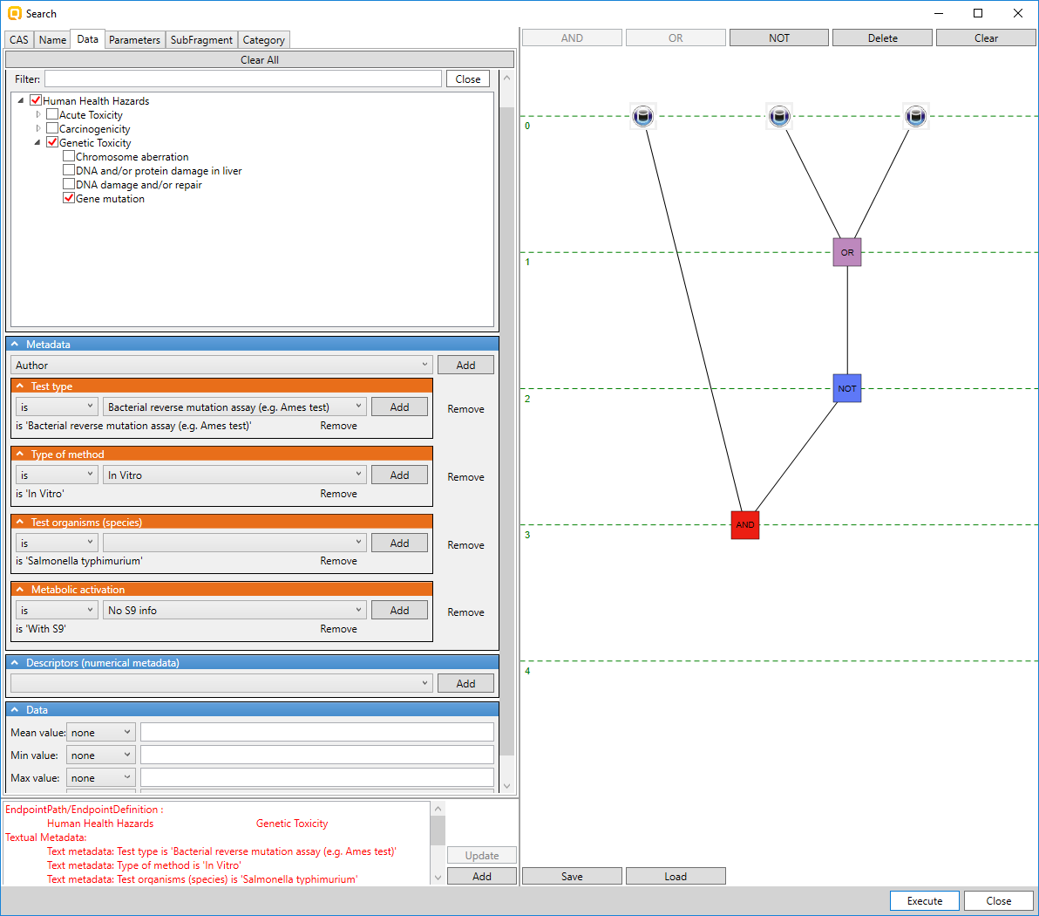
Customized search (Query Tool)
Human health hazard examples (AMES, Carcinogenicity)
Example: Mutagenic chemicals (AMES positive) which are not carcinogenic
Procedure of defining queries:
Selection of databases
Defining queries:
AMES positive
Endpoint: Gene mutation
Test type: Bacterial reverse mutation assay (e.g. Ames)
Type of method: In vitro
Species: S. typhimurium
Metabolism: with S9
Scale: Gene mutation I
Data: Positive
Negating queries
Combining queries by logical operator AND
28
Notes:
28
28

Slide 29
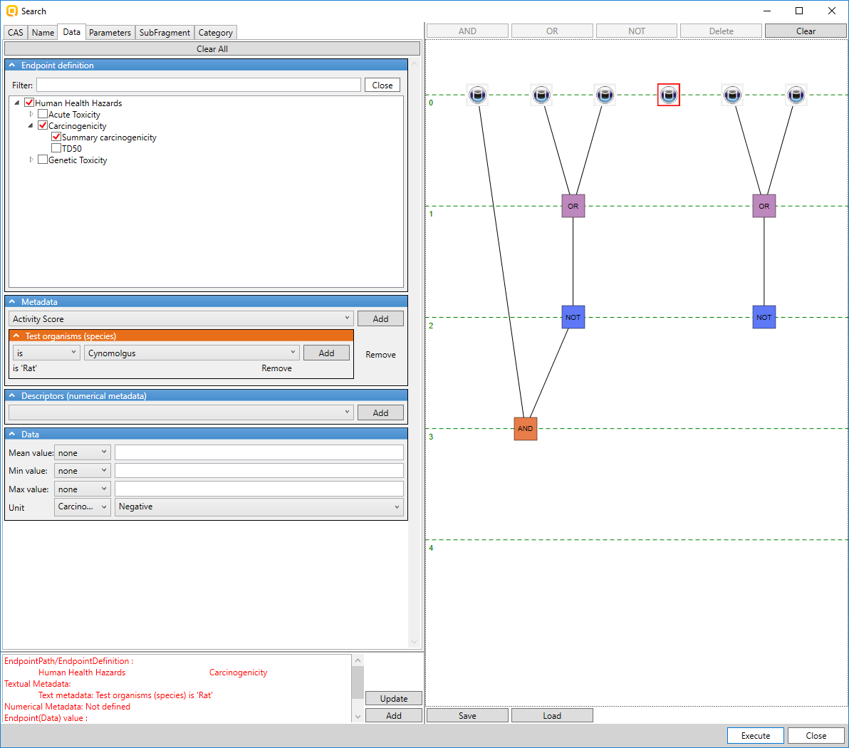
Customized search (Query Tool)
Human health hazard examples (AMES, Carcinogenicity)
Example: Mutagenic chemicals (AMES positive) which are not carcinogenic
Procedure of defining queries:
Selection of databases
Defining queries:
Carcinogenic negative
Endpoint: Summary carcinogenicity
Species: rat
Scale: Carcinogenicity I (ISSCAN)
Data: Negative
Endpoint: Summary carcinogenicity
Species: rat
Negative query
Data: negative
Scale: Carcinogenicity I (ISSCAN)
29
Notes:
29
29

Slide 30
Customized search (Query Tool)
Human health hazard examples (AMES, Carcinogenicity)
Example: Mutagenic chemicals (AMES positive) which are not carcinogenic
Procedure of defining queries:
Selection of databases
Defining queries:
Carcinogenic negative
Endpoint: Summary carcinogenicity
Species: rat
Scale: Carcinogenicity (ISSCAN)
Data: Negative
Excluding positive and equivocal chemicals
Endpoint: Summary carcinogenicity
Species: rat
Positive and equivocal chemicals are excluded
Data: negative
Scale: Carcinogenicity (ISSCAN)
30
Notes:
30
30

Slide 31
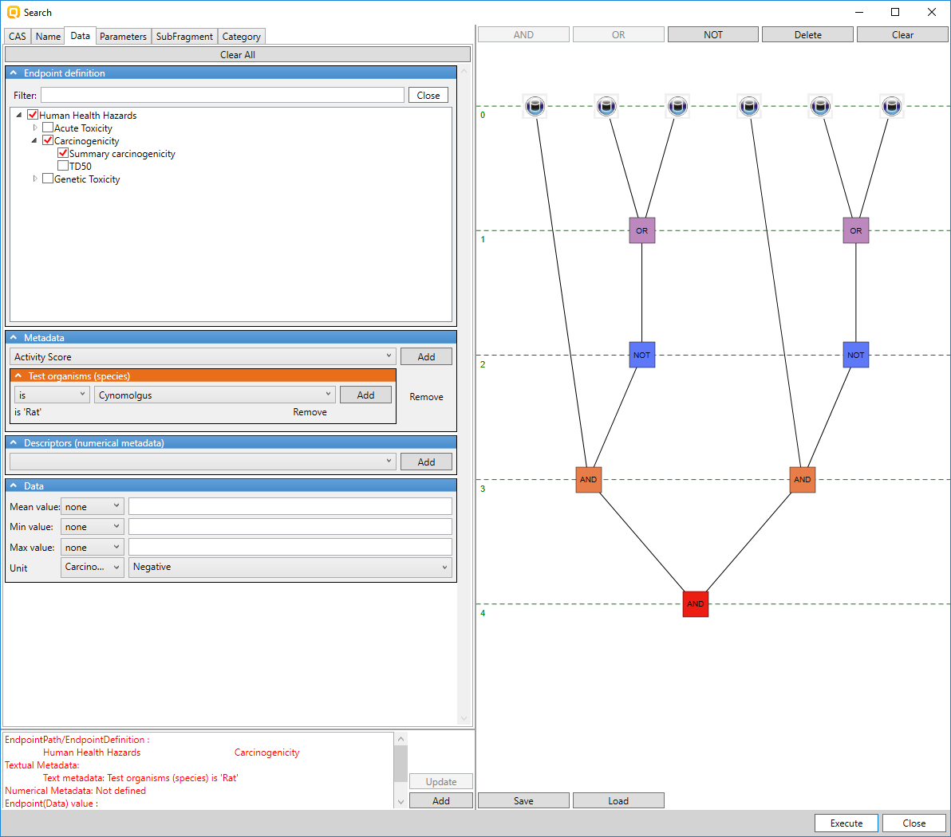
Customized search (Query Tool)
Human health hazard examples (AMES, Carcinogenicity)
Example: Mutagenic chemicals (AMES positive) which are not carcinogenic
Procedure of defining queries:
Selection of databases
Defining queries
Combining queries
Ames positive
Carcinogenic negative
Combining queries
31
Notes:
31
31

Slide 32
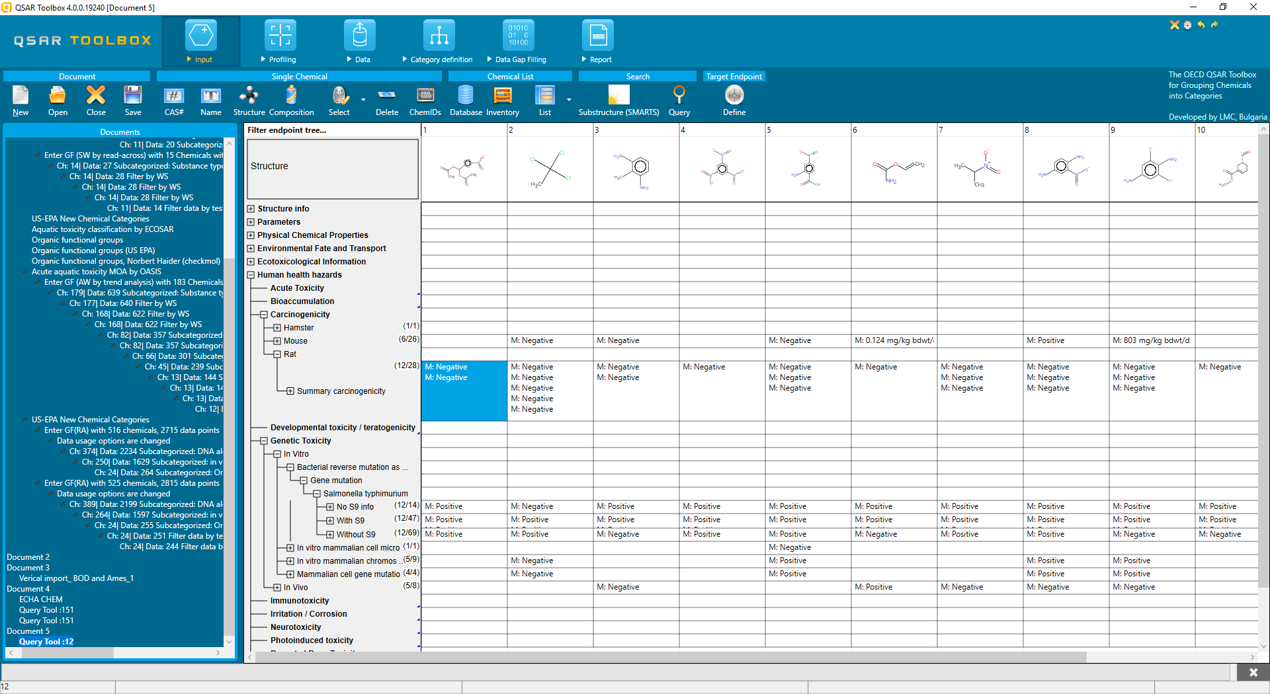
Customized search (Query Tool)
Human health hazard examples (AMES, Carcinogenicity)
Example: Mutagenic chemicals (AMES positive) which are not carcinogenic
Results: 12 chemicals meeting the searched criteria
32
Notes:
32
32

