Slide 1
QSAR Toolbox
Database Import/Export
Laboratory of Mathematical Chemistry,
Bourgas University “Prof. Assen Zlatarov”
Bulgaria

Slide 2
Outlook
Definition of Database/Inventory
Database Import
Export Data matrix
Data import from IU6
Data export to IU6
2
Notes:
2
2

Slide 3
Outlook
Definition of Database/Inventory
Database Import
Export Data matrix
Data import from IU6
Data export to IU6
3
Notes:
3
3

Slide 4
Outlook
Database:
Database is collection of structures accompanied with experimental data
Inventory:
Inventory is collection of structures without experimental data
4
Notes:
4
4

Slide 5
Outlook
Definition of Database/Inventory
Database Import
Export Data matrix
Data import from IU6
Data export to IU6
5
Notes:
5
5

Slide 6
Import databases
Goal: to import chemicals with experimental data into Toolbox.
6
Notes:
6
6

Slide 7
Import databases
Goal: to import chemicals with experimental data into Toolbox.
Outcome: building custom databases
7
Notes:
7
7

Slide 8
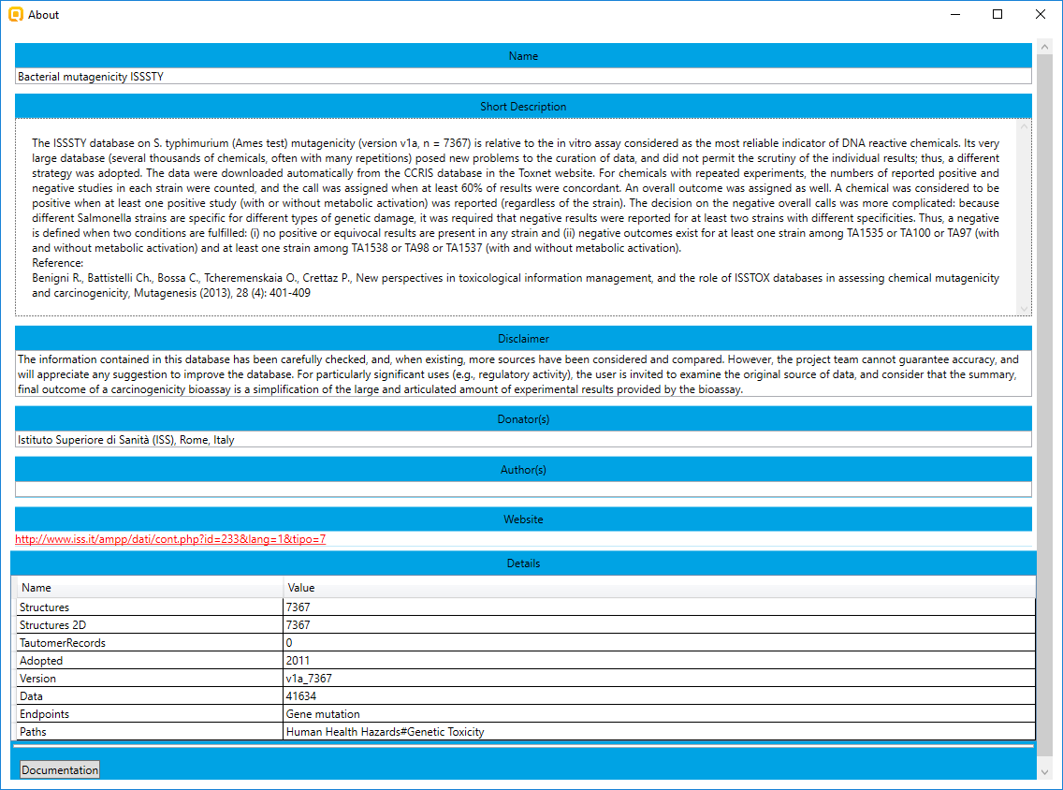
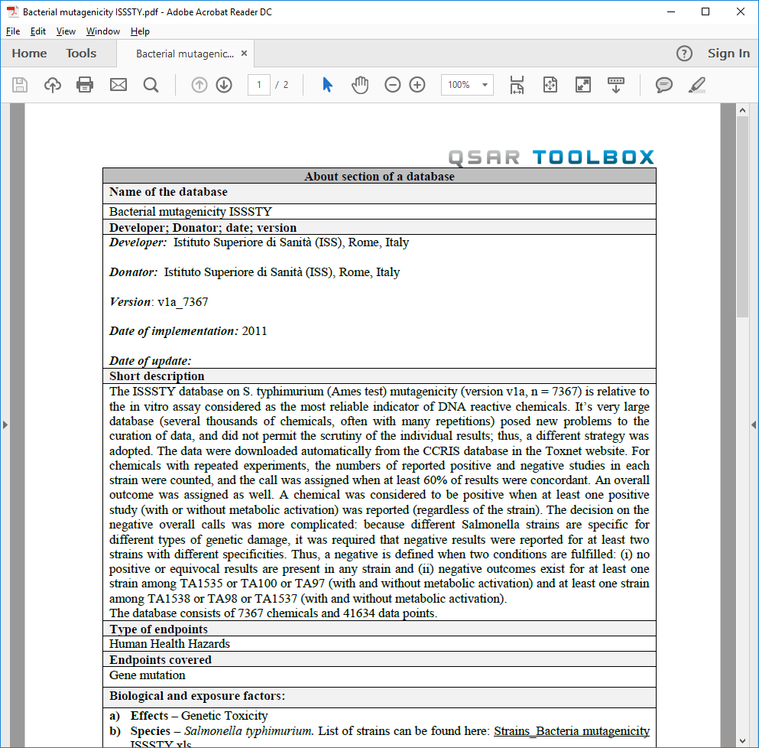
Import databases
Goal: to import chemicals with experimental data into Toolbox.
Outcome: building custom databases
Supporting documentation
8
Notes:
8
8

Slide 9
Import databases
Types of import
Vertical
Horizontal
9
Notes:
9
9

Slide 10
Import databases
Types of import
Vertical import:
It is appropriate for a set of chemicals with consistent experimental data and same supporting information (e.g. endpoint, test organism, test condition, author etc.).
10
Notes:
10
10

Slide 11
Import databases
Types of import
Vertical import layout
11
Notes:
11
11

Slide 12
Import databases
Types of import
Vertical import layout
Substance information
12
Notes:
12
12

Slide 13
Import databases
Types of import
Vertical import layout
Experimental data
13
Notes:
13
13

Slide 14
Import databases
Types of import
Vertical import layout
Example
Each columns defines data points for a single experiment.
14
Notes:
14
14

Slide 15
Import databases
Types of import
Vertical import layout
Example
Supporting information
Unit: mg/L
Effect: Mortality
Species: P. promelas
Duration: 96
Reference: Chem. Res. Toxicol., 18 (3), 536 -555.
Author: Russom, C.L
15
Notes:
15
15

Slide 16
Import databases
Types of import
Vertical import layout
Example
Supporting information
Unit: mg/L
Effect: Mortality
Species: P. promelas
Duration: 96
Reference: Chem. Res. Toxicol., 18 (3), 536 -555.
Author: Russom, C.L
Organ: Skin
Test method: LLNA
Type of method: in vivo
Reference: ExxonMobile
16
Notes:
16
16

Slide 17
Import databases
Types of import
Vertical import layout
Example
Supporting information is added manually
Unit: mg/L
Effect: Mortality
Species: P. promelas
Duration: 96
Reference: Chem. Res. Toxicol., 18 (3), 536 -555.
Author: Russom, C.L
Organ: Skin
Test method: LLNA
Type of method: in vivo
Reference: ExxonMobile
17
Notes:
17
17

Slide 18
Import databases
Types of import
Vertical import example
Guidance illustrating how to import custom database by vertical layout is available in tutorial “Example for Import/Export of custom databases.ppt”
18
Notes:
18
18

Slide 19
Import databases
Types of import
Horizontal import:
It is appropriate for a set of chemicals with different types of experimental data accompanied with supporting information (endpoints, test condition, test organism, author etc).
19
Notes:
19
19

Slide 20
Import databases
Types of import
Horizontal import layout
Substance information
Endpoint path
Experiment information
Hard part of endpoint tree
20
Notes:
20
20

Slide 21
Import databases
Types of import
Horizontal import layout
Experiment information
Endpoint type
Observed value
Supporting information
21
Notes:
21
21

Slide 22
Import databases
Types of import
Horizontal import layout
Experiment information
Different type endpoints are presented on separate rows
Each row defines a single data points for a chemical
22
Notes:
22
22

Slide 23
Import databases
Types of import
Horizontal import layout
Example
23
Notes:
23
23

Slide 24
Import databases
Types of import
Horizontal import layout
Example
Rigid
Endpoint data associated with “Ecotoxicological Information#Aquatic toxicity” rigid part of endpoint tree
Rigid part is bolded
Dynamic
24
Notes:
24
24

Slide 25
Import databases
Types of import
Horizontal import layout
Experiment information
Example
Endpoint type
25
Notes:
25
25

Slide 26
Import databases
Types of import
Horizontal import layout
Experiment information
Example
Data value for the experiment
26
Notes:
26
26

Slide 27
Import databases
Types of import
Horizontal import layout
Experiment information
Example
Data unit for the experiment
27
Notes:
27
27

Slide 28
Import databases
Types of import
Horizontal import example
Guidance illustrating how to import custom database by horizontal layout is available in tutorial “Example for Import/Export of custom databases.ppt”
28
Notes:
28
28

Slide 29
Outlook
Definition of Database/Inventory
Database Import
Export Data matrix
Data import from IU6
Data export to IU6
29
Notes:
29
29

Slide 30
Export Data matrix
Types of export
Vertical
Horizontal
30
Notes:
30
30

Slide 31
Export Data matrix
Types of export
Vertical export
Possibility to export chemicals with data and supporting information (e.g. profiling results, 2D/3D parameters, molecular formula etc.) available on Data matrix in text format organized in a vertical layout.
Two options of export:
Export row from data matrix
Export whole data matrix
31
Notes:
31
31

Slide 32
Export Data matrix
Types of export
Vertical export example
Data and Profiling results for export
32
Notes:
32
32

Slide 33
Export Data matrix
Types of export
Vertical export example
33
Notes:
33
33

Slide 34
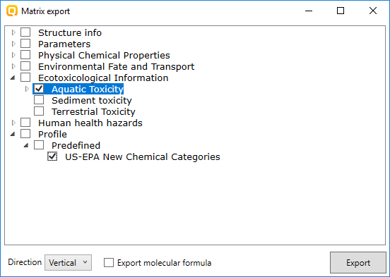
Export Data matrix
Types of export
Vertical export example
Data
Profiling results
34
Notes:
34
34

Slide 35
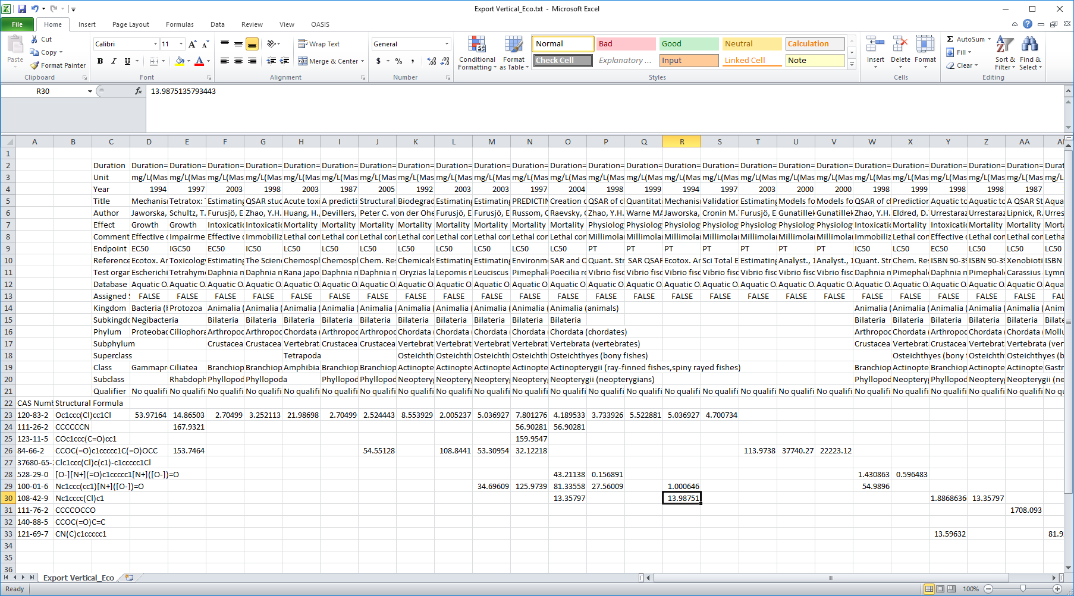
Export Data matrix
Types of export
Vertical export example
Metadata information
Experimental data organized in vertical order
35
Notes:
35
35

Slide 36
Export Data matrix
Types of export
Horizontal export
Possibility to export chemicals with data and supporting information (e.g. profiling results, 2D/3D parameters, molecular formula, etc.) available on Data matrix in text format organized in a horizontal layout.
Two options of export:
Export row from data matrix
Export whole data matrix
36
Notes:
36
36

Slide 37
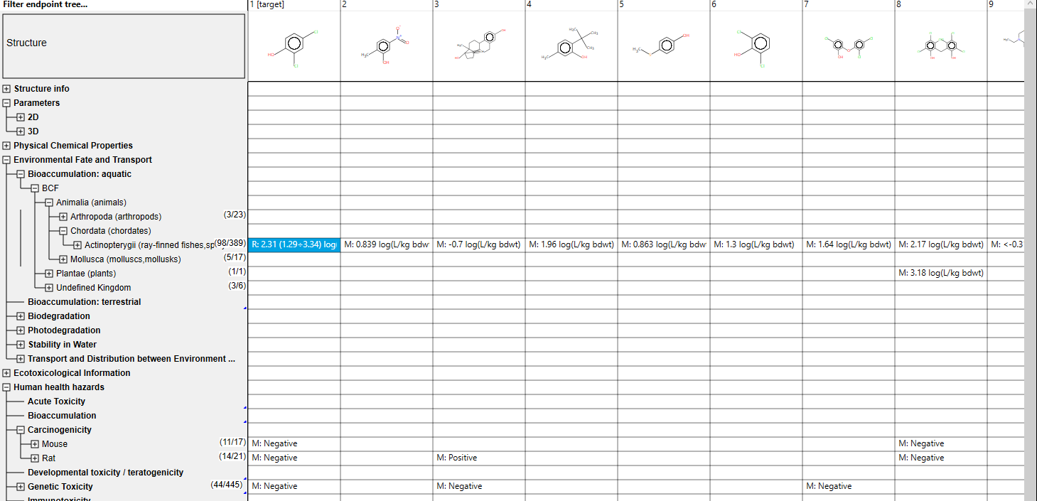
Export Data matrix
Types of export
Horizontal export example
Read-across prediction
Experimental data for BCF
Experimental data for carcinogenicity & mutagenicity
37
Read-across prediction and experimental results for export
Notes:
37
37

Slide 38
Export Data matrix
Types of export
Horizontal export example
Export single row
Export whole Data matrix
38
Notes:
38
38

Slide 39
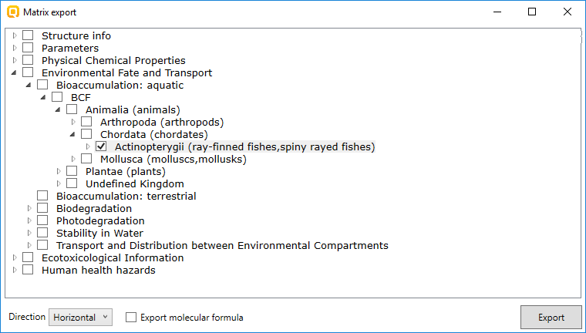
Export Data matrix
Types of export
Horizontal export example
Export Data and RA prediction from a row
39
Notes:
39
39

Slide 40
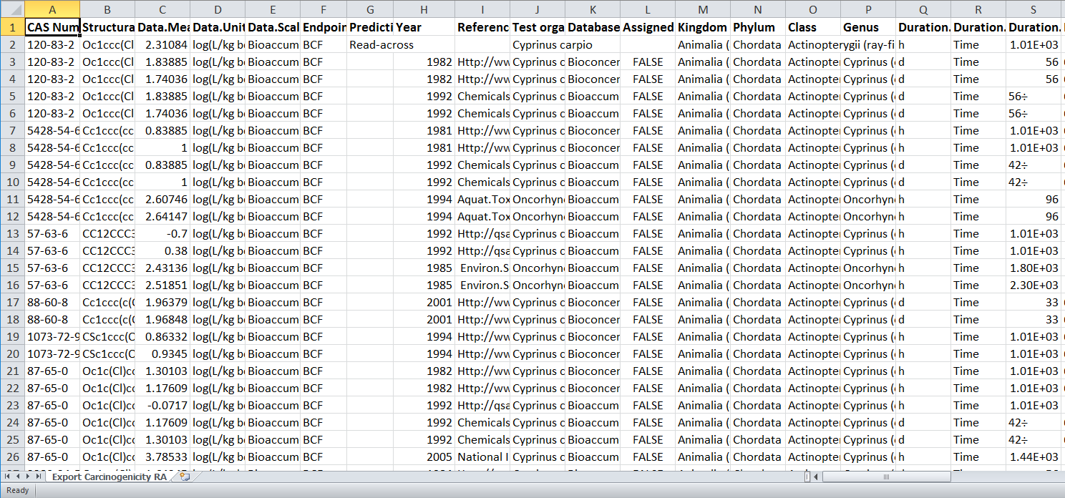
Export Data matrix
Types of export
Horizontal export example
RA
Data
Experimental data and RA prediction
Metadata
40
Experimental data and RA prediction organized in horizontal order
Notes:
40
40

Slide 41
Outlook
Definition of Database/Inventory
Database Import
Export Data matrix
Data import from IU6
Data export to IU6
41
Notes:
41
41

Slide 42
Data import from IU6
Import to Toolbox via IU6z files
Import to Toolbox via Webservices
Functionalities postponed for v 4.1
42
Notes:
42
42

Slide 43
Outlook
Definition of Database/Inventory
Database Import
Export Data matrix
Data import from IU6
Data export to IU6
43
Notes:
43
43

Slide 44
Data export to IU6
Export of predictions to IU6 via IU6z files
Export of predictions to IU6 via Webservices
44
Notes:
44
44

Slide 45
Data export to IU6
Export of predictions to IU6 via IU6z files – postponed for 4.1 version
Export of predictions to IU6 via Webservices
45
Notes:
45
45

Slide 46
Data export to IU6
Export of predictions to IU6 via IU6z files – postponed for 4.1 version
Export of predictions to IU6 via Webservices
46
Notes:
46
46

Slide 47
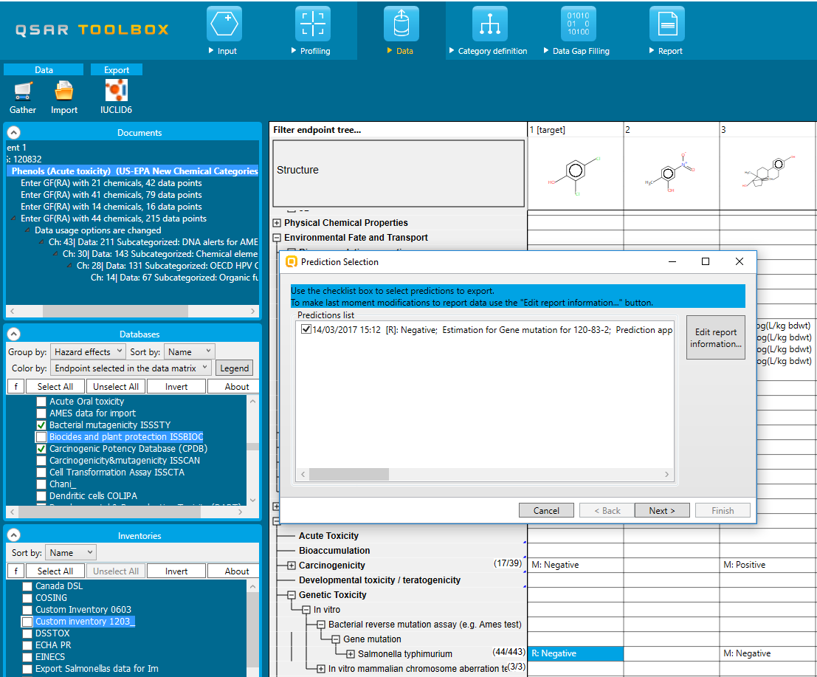
Data export to IU6
Webservices
Export of predictions to IU6 via Webservices
Once the prediction is created, for the target chemical, it could be transferred to IU6 via Webservices
Target: CAS 120-83-2
Export procedure: Selection of prediction to export
Predicted endpoint:
AMES without S9
RA: Negative
47
Notes:
47
47

Slide 48
Data export to IU6
Webservices
Export of predictions to IU6 via Webservices
Once the prediction is created, for the target chemical, it could be transferred to IU6 via Webservices
Target: CAS 120-83-2
Export: possibility to edit Toolbox report before transferring to IU6
Predicted endpoint:
AMES without S9
RA: Negative
48
Notes:
48
48

Slide 49
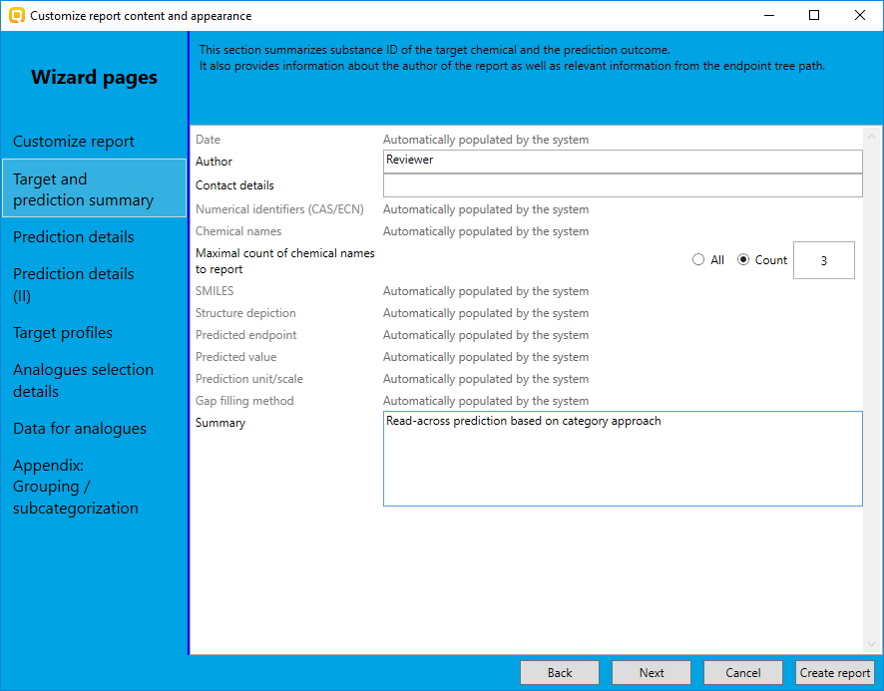
Data export to IU6
Webservices
Export of predictions to IU6 via Webservices
Once the prediction is created, for the target chemical, it could be transferred to IU6 via Webservices
Target: CAS 120-83-2
Export: possibility to edit Toolbox report before transferring to IU6
Manually editable fields
Predicted endpoint:
AMES without S9
RA: Negative
Manually editable fields
49
Notes:
49
49

Slide 50
Data export to IU6
Webservices
Export of predictions to IU6 via Webservices
Once the prediction is created, for the target chemical, it could be transferred to IU6 via Webservices
Target: CAS 120-83-2
Export procedure: assigning prediction to the corresponding OECD template
Predicted endpoint:
AMES without S9
RA: Negative
50
Notes:
50
50

Slide 51
Data export to IU6
Webservices
Export of predictions to IU6 via Webservices
Once the prediction is created, for the target chemical, it could be transferred to IU6 via Webservices
Target: CAS 120-83-2
Export procedure: connecting to IU6 server
Predicted endpoint:
AMES without S9
RA: Negative
51
Notes:
51
51

Slide 52
Data export to IU6
Webservices
Export of predictions to IU6 via Webservices
Once the prediction is created, for the target chemical, it could be transferred to IU6 via Webservices
Target: CAS 120-83-2
Export procedure: specifying the media
Predicted endpoint:
AMES without S9
RA: Negative
52
Notes:
52
52

Slide 53
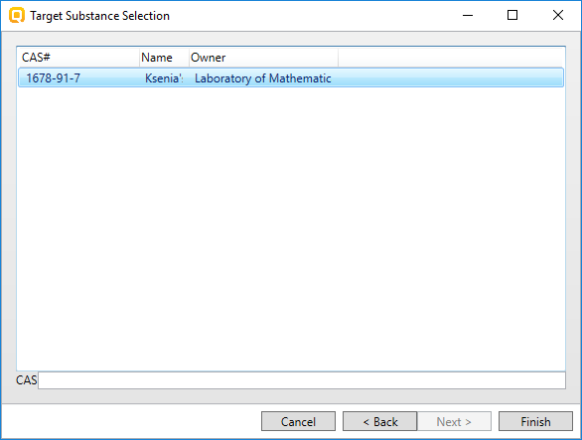
Data export to IU6
Webservices
Export of predictions to IU6 via Webservices
Once the prediction is created, for the target chemical, it could be transferred to IU6 via Webservices
Target: CAS 120-83-2
Export procedure: selecting substance to export the prediction
Predicted endpoint:
AMES without S9
RA: Negative
53
Notes:
53
53

Slide 54
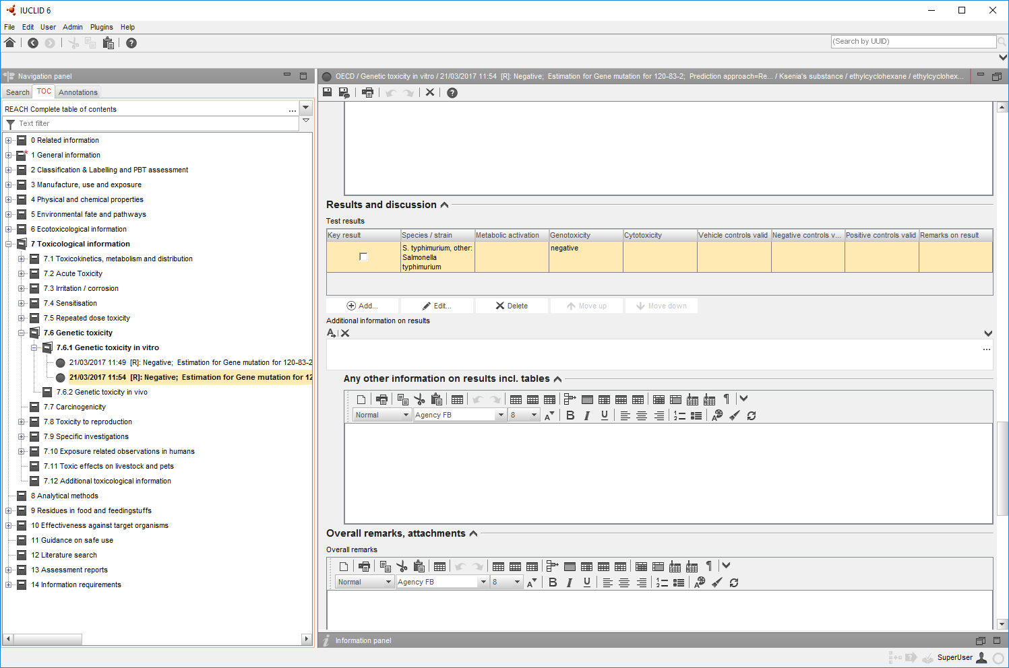
Data export to IU6
Webservices
View of transferred RA prediction in IU6
Target: CAS 120-83-2
Predicted value
Endpoint study record
Predicted endpoint:
AMES without S9
RA: Negative
Data and prediction report are automatically assigned to the substance
54
Notes:
54
54

Slide 55
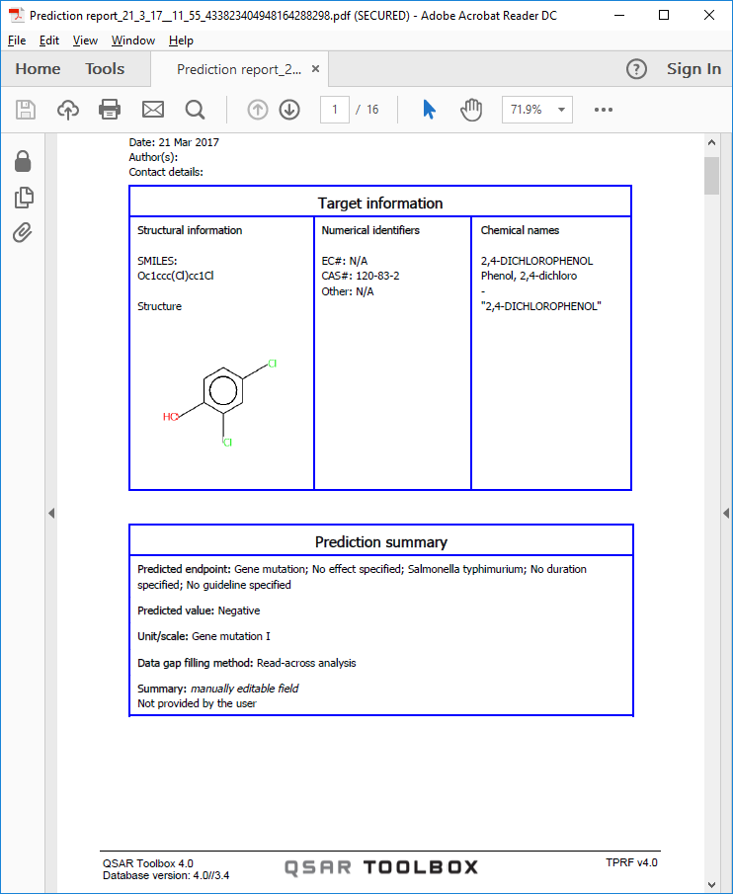
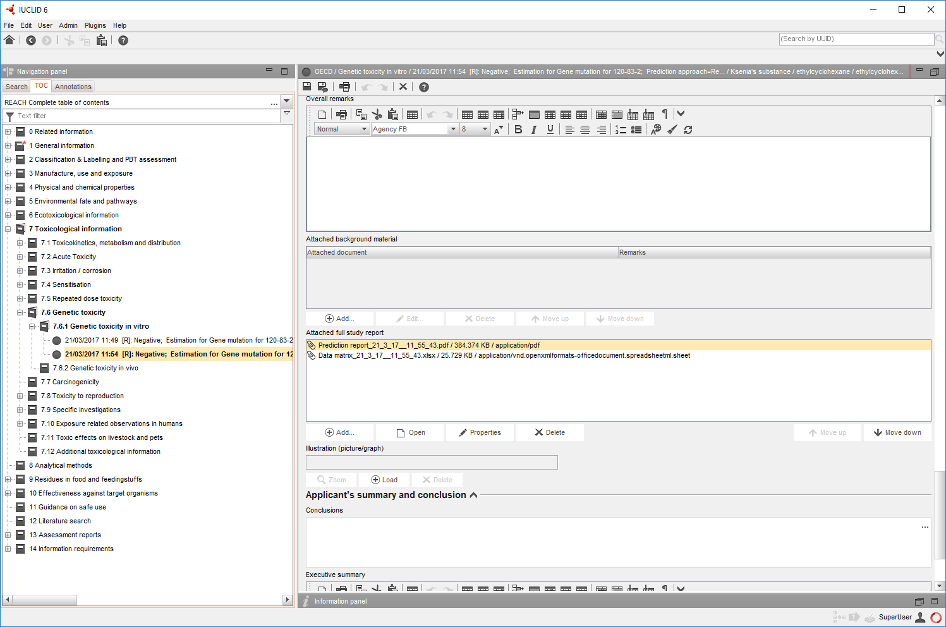
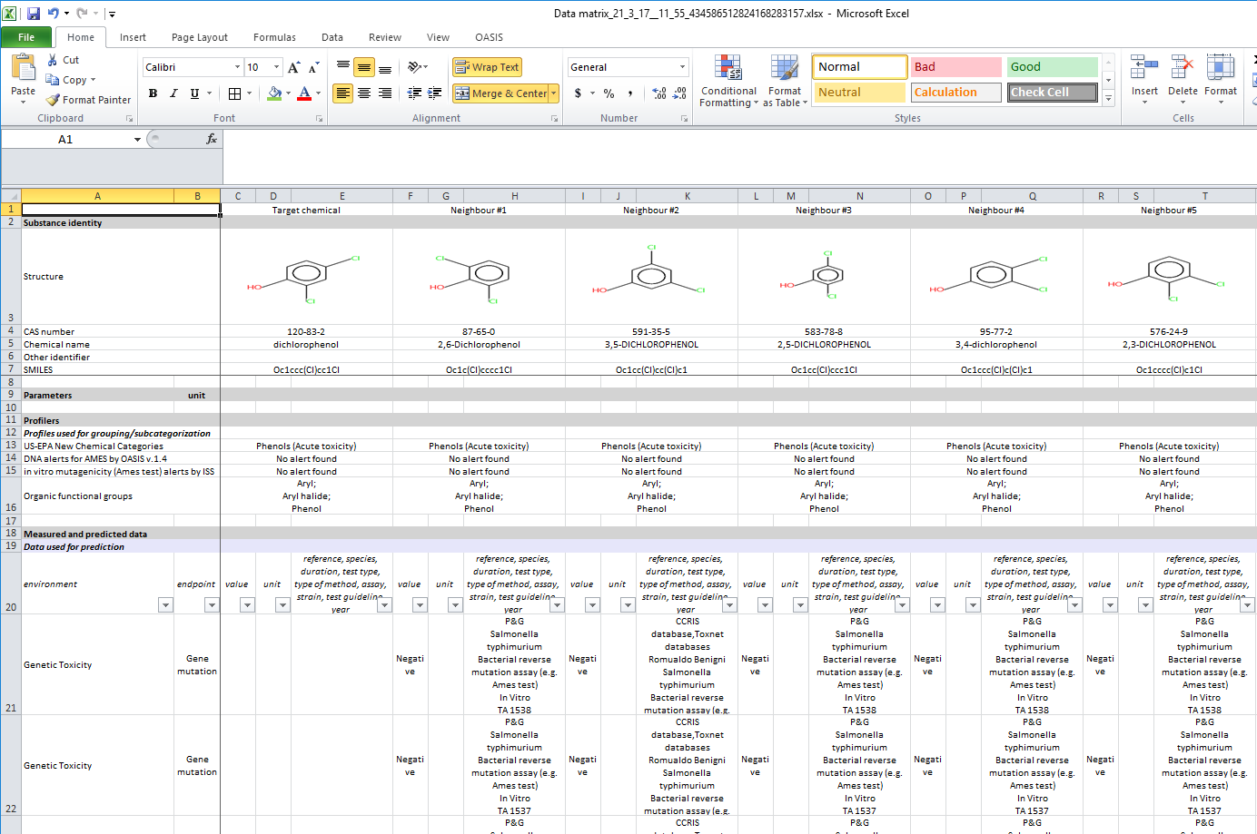
Data export to IU6
Webservices
Prediction report
View of transferred RA prediction in IU6
Target: CAS 120-83-2
Data matrix report
Predicted endpoint:
AMES without S9
RA: Negative
Toolbox reports are attached
Data and prediction report are automatically assigned to the substance
55
Notes:
55
55

Slide 56
Summary
Database Import:
Vertical import - consistent endpoint data (no supporting information)
Horizontal import – endpoint data supported with additional information
Export data matrix:
Vertical layout – data are exported in vertical order
Horizontal layout – data are exported in horizontal order
Import data from IU6 to Toolbox:
Import via IU6z file and Webservices – postponed for v4.1
Export data from Toolbox to IU6:
Import via IU6z file – postponed for v4.1
Export of prediction to IU6 via Webservices
56

